Slide 1
MH6142 Database Systems Hands-On Project
G2103131A WU MINGJING
G2103195K ZHANG BOJUN
G2103160J ZHOU DUO

Slide 2
PART 1:
Database Building

Slide 3
Research Background
The Real-World Problem:
It is crucial in the F&B industry for restaurants to know the number of customers visiting in advance to effectively purchase ingredients and schedule staff members. Generally, such forecast is not easy as there are many unpredictable factors affecting the actual number of customers. It's even more challenging for newer restaurants with little historical data.
In this project, we will look into such real - world problem in Japan by using the dataset provided by Recruit Holdings to make some predictions.
Kaggle Competition Link:
https://www.kaggle.com/c/recruit-restaurant-visitor-forecasting
Notes:
问题和需求简单一页概括，毕竟重点是可视化，突出分析难就可

Slide 4
Problem Statement
Reservation and visitation data are provided from two systems:
Hot Pepper Gourmet (hpg): similar to Yelp, users can search restaurants and make a reservation online.
AirREGI / Restaurant Board (air): similar to Square, a reservation control and cash register system.
Both have different list of restaurants and customers can make reservations through two systems.
Problem statement:
Using past reservation and visitation data to predict the total number of visitors of air restaurants for future dates and meanwhile draw interesting insights from the analysis.
Notes:
问题和需求简单一页概括，毕竟重点是可视化，突出分析难就可

Slide 5
Problem Statement
For this project, we will only use the AirREGI / Restaurant Board (air) data. Why?
As compared to the air data, insufficient data provided for the Hot Pepper Gourmet (hpg), such as the actual number of customers visiting restaurants. We cannot extract useful information from it and do accurate prediction. The AirREGI / Restaurant Board (air) data has both reservation data and visitation data, we can explore more meaningful pattern and make predictions for the future.
Notes:
问题和需求简单一页概括，毕竟重点是可视化，突出分析难就可

Slide 6
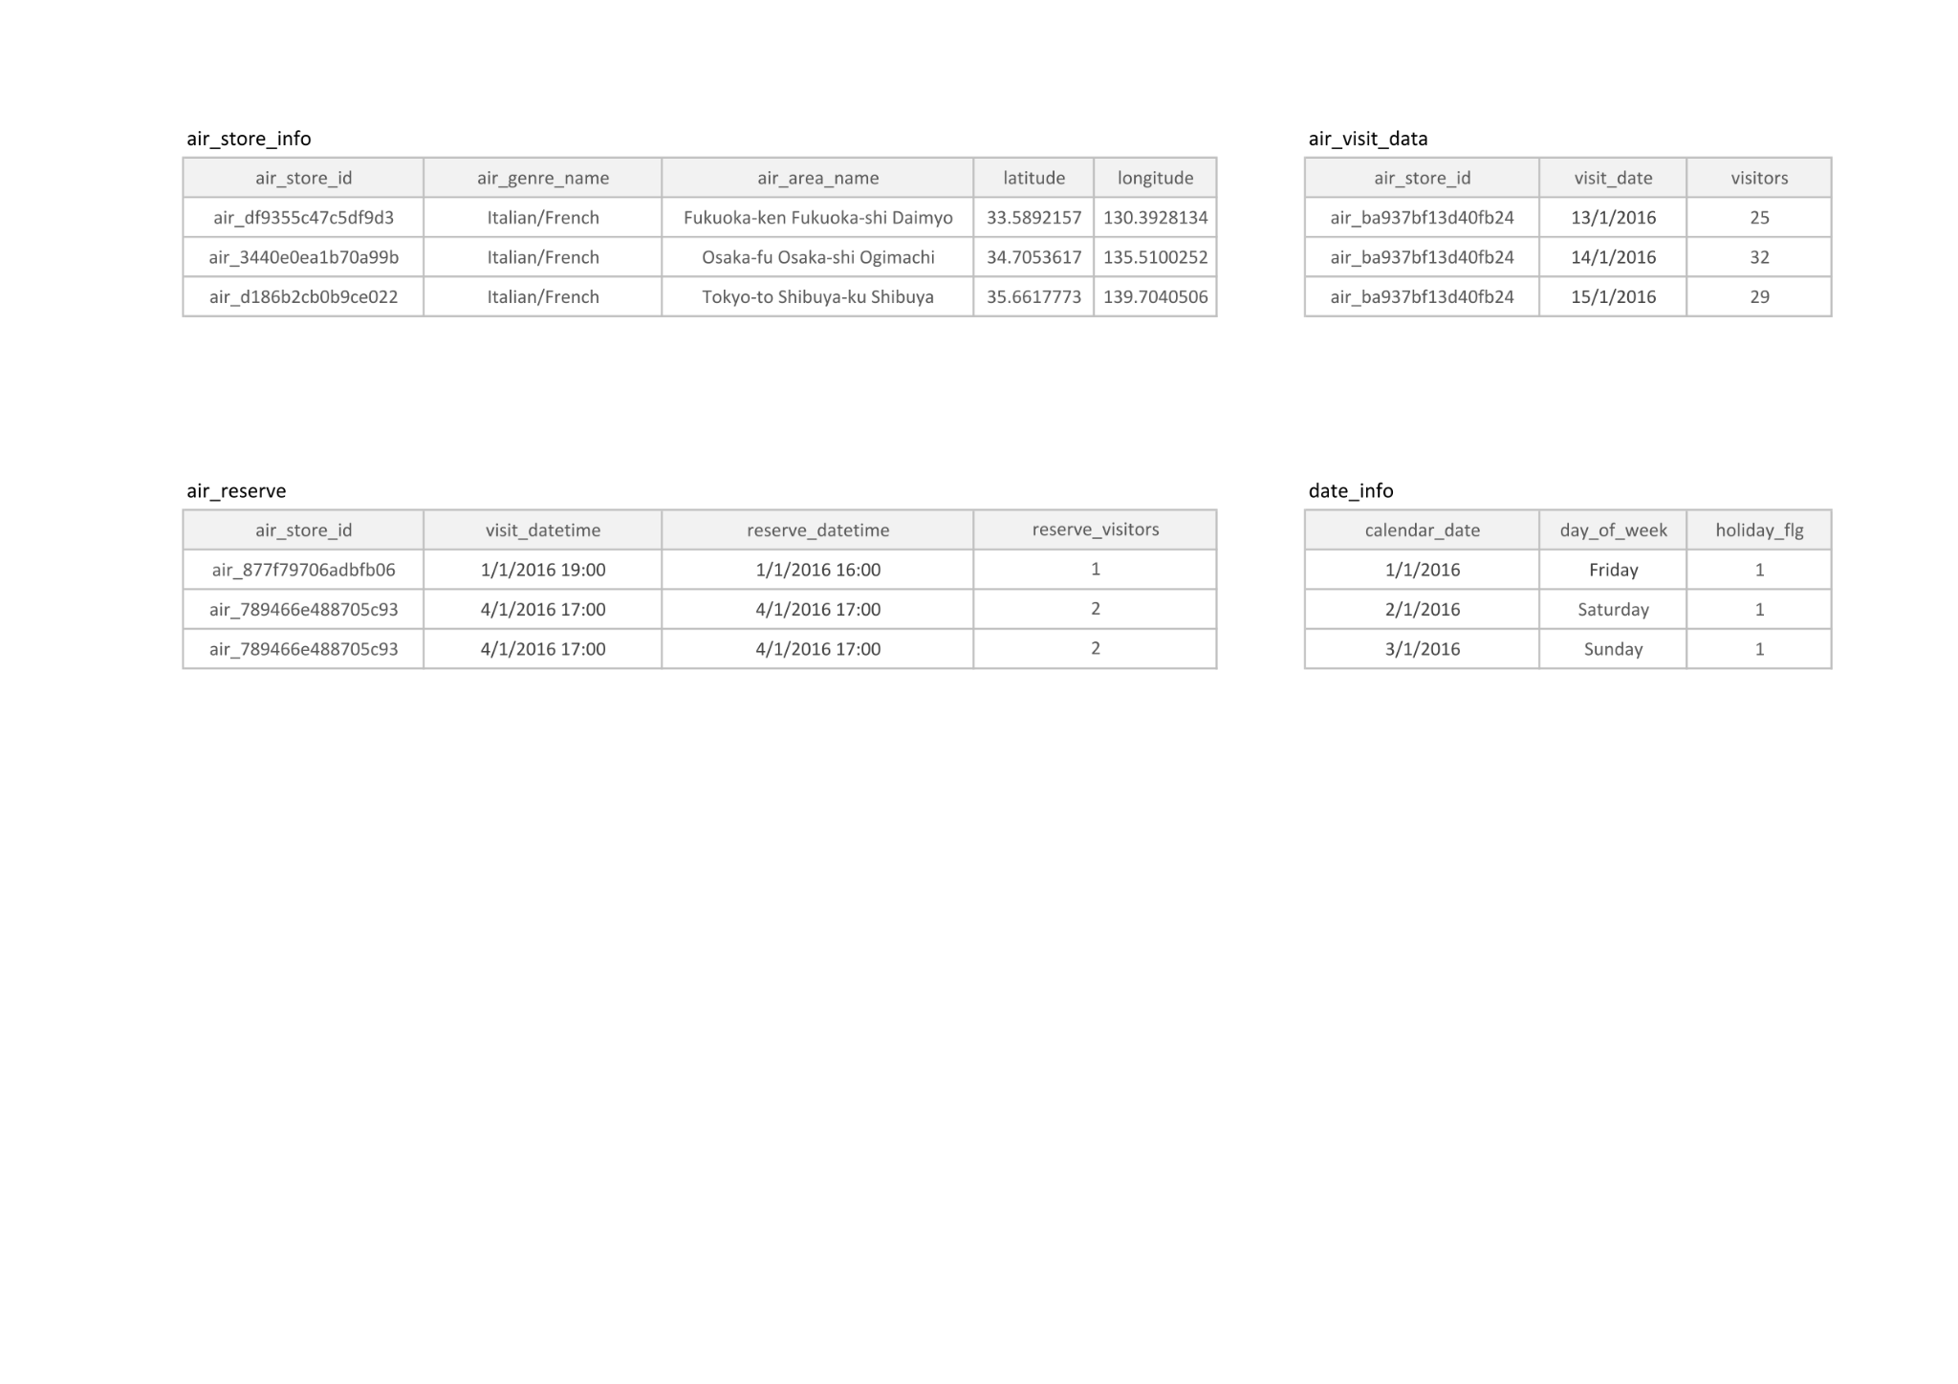
Data Set Information
air_store_id
air_genre_name: food style
air_area_name: location of the restaurant in Japan
latitude: geolocation information
longitude: geolocation information
air_store_id
visit_date
visitors: the number of visitors to the restaurant on the date
air_store_id: restaurant id in air system
visit_datetime: time of reservation
reserve_datetime: time reservation was made
reserve_visitors: number of visitors for that reservation
calendar_date
day_of_week
holiday_flg: whether the day is a holiday in Japan

Slide 7
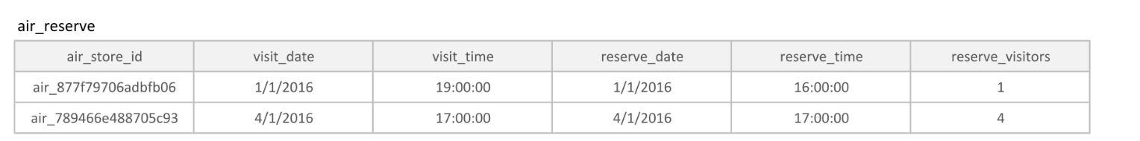
Air_reserve Adjustment
Separate date and time, aggregate number of visitors under the same day and same time
air_reserve <- air_reserve %>%
mutate(reserve_date = date(reserve_datetime),
reserve_time = format(reserve_datetime, format = "%H:%M:%S"),
visit_date = date(visit_datetime),
visit_time = format(visit_datetime, format = "%H:%M:%S"))
air_reserve <- air_reserve[,c(1,7,8,5,6,4)]
air_reserve_aggregate <- air_reserve %>%
group_by(air_store_id,visit_date,visit_time,reserve_date,reserve_time) %>%
summarise_all(sum)
write.csv(air_reserve_aggregate,"D:\\NTU\\Database System\\Group Project\\adjusted csv\\air_reserve.csv", row.names = FALSE)

Slide 8
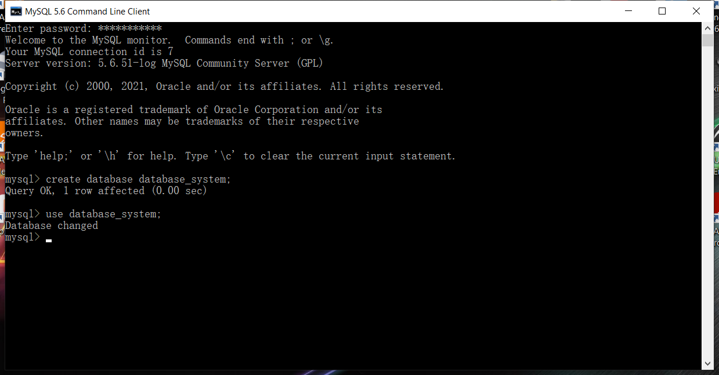
Local Database Creation
First, we create local database through MySQL5.6:

Slide 9
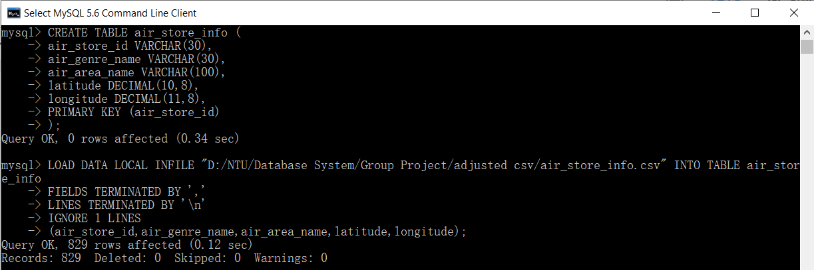
Local Database Creation
Create table air_store_info
CREATE TABLE air_store_info (
air_store_id VARCHAR(30),
air_genre_name VARCHAR(30),
air_area_name VARCHAR(100),
latitude DECIMAL(10,8),
longitude DECIMAL(11,8),
PRIMARY KEY (air_store_id)
);
LOAD DATA LOCAL INFILE "D:/NTU/Database System/Group Project/adjusted csv/air_store_info.csv" INTO TABLE air_store_info
FIELDS TERMINATED BY ','
LINES TERMINATED BY '\n'
IGNORE 1 LINES
(air_store_id,air_genre_name,air_area_name,latitude,longitude);

Slide 10
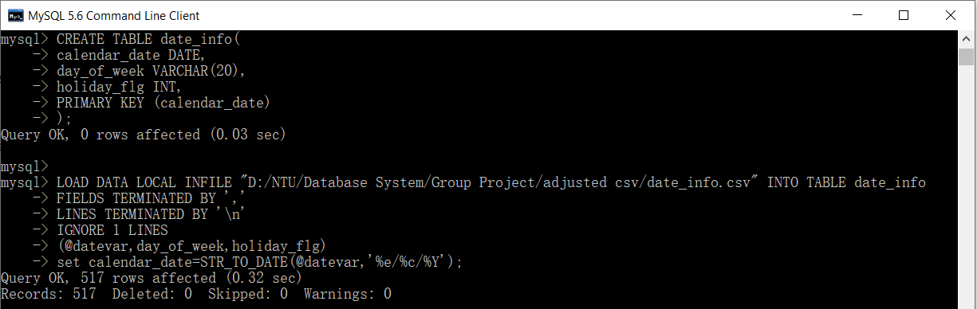
Local Database Creation
Create table date_info
CREATE TABLE date_info(
calendar_date DATE,
day_of_week VARCHAR(20),
holiday_flg INT,
PRIMARY KEY (calendar_date)
);
LOAD DATA LOCAL INFILE "D:/NTU/Database System/Group Project/adjusted csv/date_info.csv" INTO TABLE date_info
FIELDS TERMINATED BY ','
LINES TERMINATED BY '\n'
IGNORE 1 LINES
(@datevar,day_of_week,holiday_flg)
set calendar_date=STR_TO_DATE(@datevar,'%e/%c/%Y');

Slide 11
Local Database Creation
Create table air_reserve
CREATE TABLE air_reserve (
air_store_id VARCHAR(30),
visit_date DATE,
visit_time TIME,
reserve_date DATE,
reserve_time TIME,
reserve_visitors INT,
PRIMARY KEY (air_store_id,visit_date,visit_time,reserve_date,reserve_time),
FOREIGN KEY (air_store_id)
REFERENCES air_store_info(air_store_id),
FOREIGN KEY (visit_date)
REFERENCES date_info(calendar_date),
FOREIGN KEY (reserve_date)
REFERENCES date_info(calendar_date)
);

Slide 12
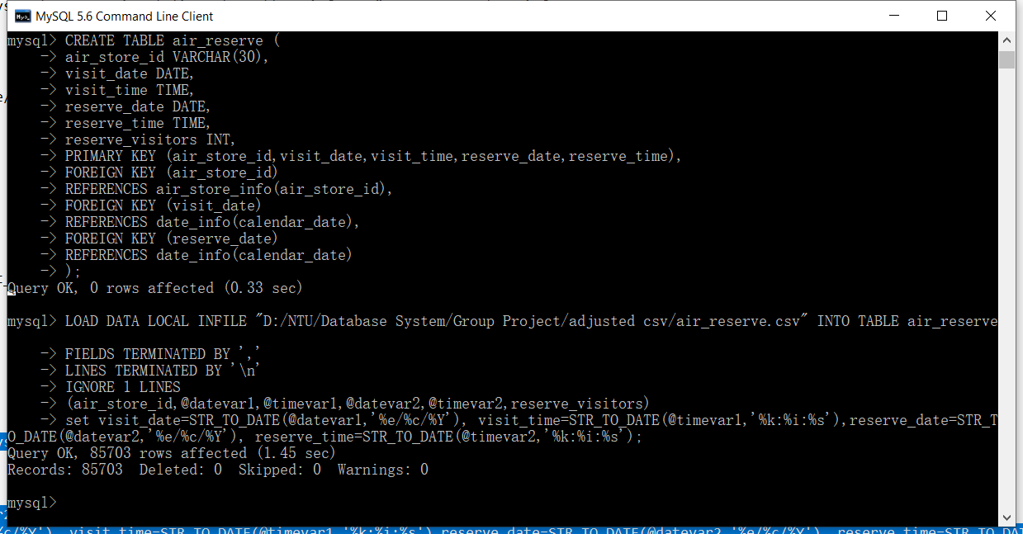
Local Database Creation
Create table air_reserve
LOAD DATA LOCAL INFILE "D:/NTU/Database System/Group Project/adjusted csv/air_reserve.csv" INTO TABLE air_reserve
FIELDS TERMINATED BY ','
LINES TERMINATED BY '\n'
IGNORE 1 LINES
(air_store_id,@datevar1,@timevar1,@datevar2,@timevar2,reserve_visitors)
set visit_date=STR_TO_DATE(@datevar1,'%e/%c/%Y'), visit_time=STR_TO_DATE(@timevar1,'%k:%i:%s'),reserve_date=STR_TO_DATE(@datevar2,'%e/%c/%Y'), reserve_time=STR_TO_DATE(@timevar2,'%k:%i:%s');

Slide 13
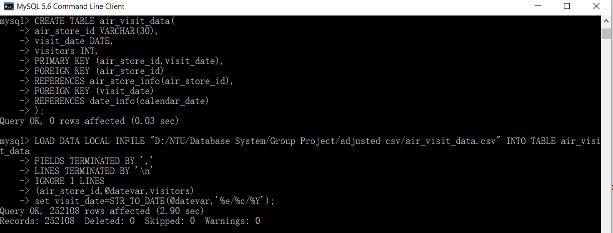
Local Database Creation
Create table air_reserve
CREATE TABLE air_visit_data(
air_store_id VARCHAR(30),
visit_date DATE,
visitors INT,
PRIMARY KEY (air_store_id,visit_date),
FOREIGN KEY (air_store_id)
REFERENCES air_store_info(air_store_id),
FOREIGN KEY (visit_date)
REFERENCES date_info(calendar_date)
);
LOAD DATA LOCAL INFILE "D:/NTU/Database System/Group Project/adjusted csv/air_visit_data.csv" INTO TABLE air_visit_data
FIELDS TERMINATED BY ','
LINES TERMINATED BY '\n'
IGNORE 1 LINES
(air_store_id,@datevar,visitors)
set visit_date=STR_TO_DATE(@datevar,'%e/%c/%Y');

Slide 14
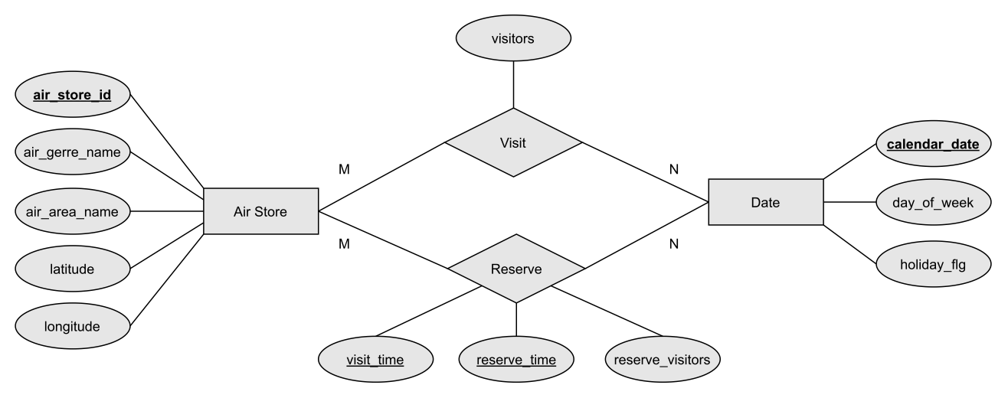
ER Diagram
Each store is visited / reserved on multiple days
Each day people visit / reserve multiple stores
Notes:
问题和需求简单一页概括，毕竟重点是可视化，突出分析难就可

Slide 15
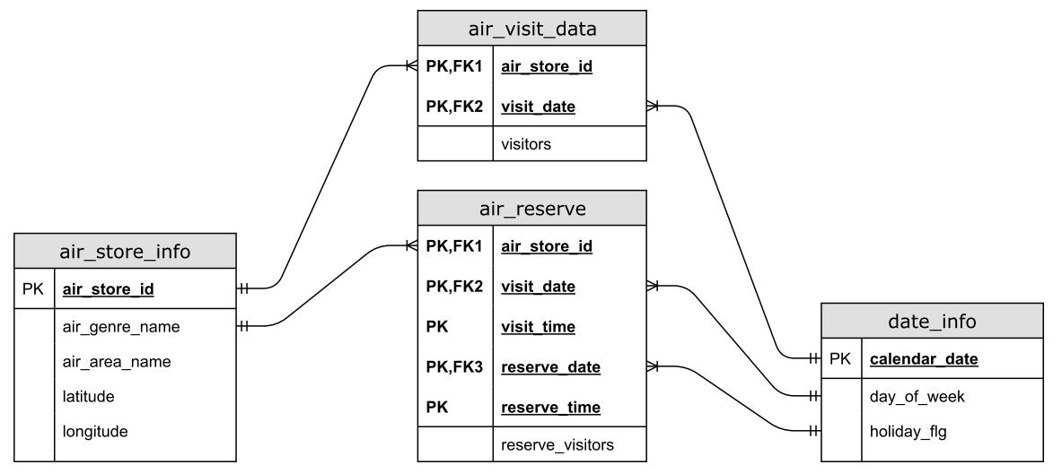
Table Relationship
Notes:
问题和需求简单一页概括，毕竟重点是可视化，突出分析难就可

Slide 16

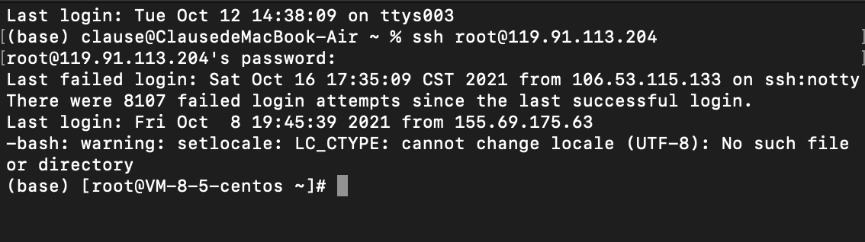
Database Server Building
Introduction
MySQL is an open-source database management system, commonly installed as part of the popular LEMP (Linux, Nginx, MySQL/MariaDB, PHP/Python/Perl) stack. It uses a relational database and SQL (Structured Query Language) to manage its data.
I bought a CentOS 7 server from Tencent Cloud with a root user with sudo privileges. You can learn more about how to set up a user with these privileges in the Initial Server Setup with CentOS 7 guide.

Slide 17

Database Server Building
Step 1 — Installing MySQL
As mentioned, the Yum command to install MySQL in fact installs MariaDB. To install MySQL, we’ll need to visit the MySQL community Yum Repository which provides packages for MySQL.
wget https://dev.mysql.com/get/mysql57-community-release-el7-9.noarch.rpm
Now that we’ll install the package:
sudo rpm -ivh mysql57-community-release-el7-9.noarch.rpm
This adds two new MySQL yum repositories, and we can now use them to install MySQL server:
sudo yum install mysql-server
Press y to confirm that you want to proceed. Since we’ve just added the package, we’ll also be prompted to accept its GPG key. Press y to download it and complete the install.

Slide 18
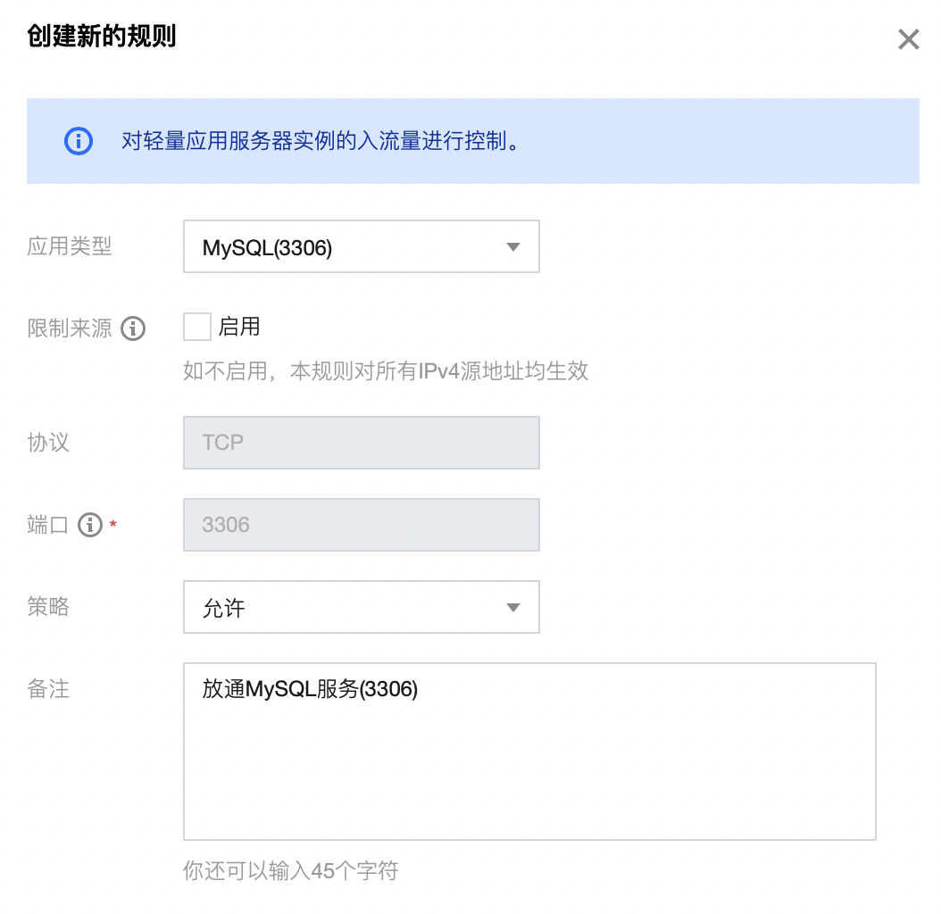
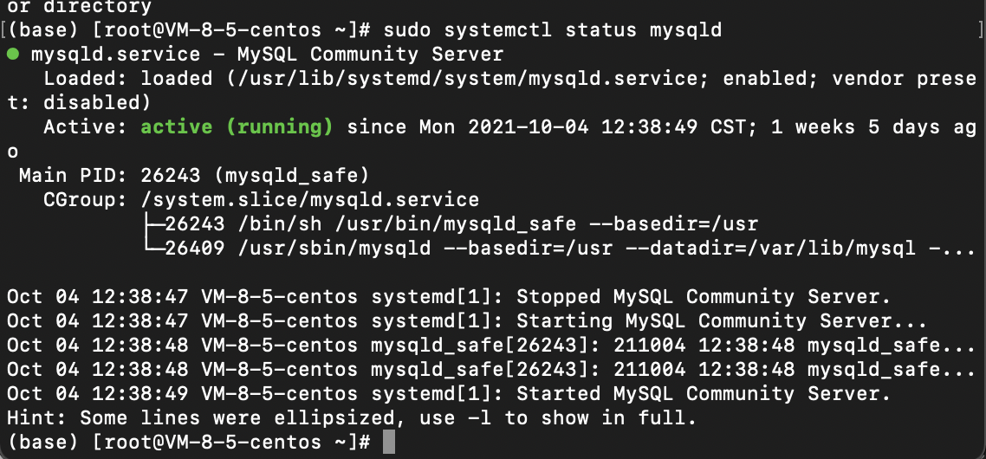
Database Server Building
Step 2 — Starting MySQL
We’ll start the daemon with the following command:
sudo systemctl start mysqld
systemctl doesn’t display the outcome of all service management commands, so to be sure we succeeded, we’ll use the following command:
sudo systemctl status mysqld
As the image, MySQL has successfully started, the output should contain Active: active (running). During the installation process, a temporary password is generated for the MySQL root user. Locate it in the mysqld.log with this command:
sudo grep 'our temporary password' /var/log/mysqld.log
The default password policy requires 12 characters, with at least one uppercase letter, one lowercase letter, one number and one special character.

Slide 19
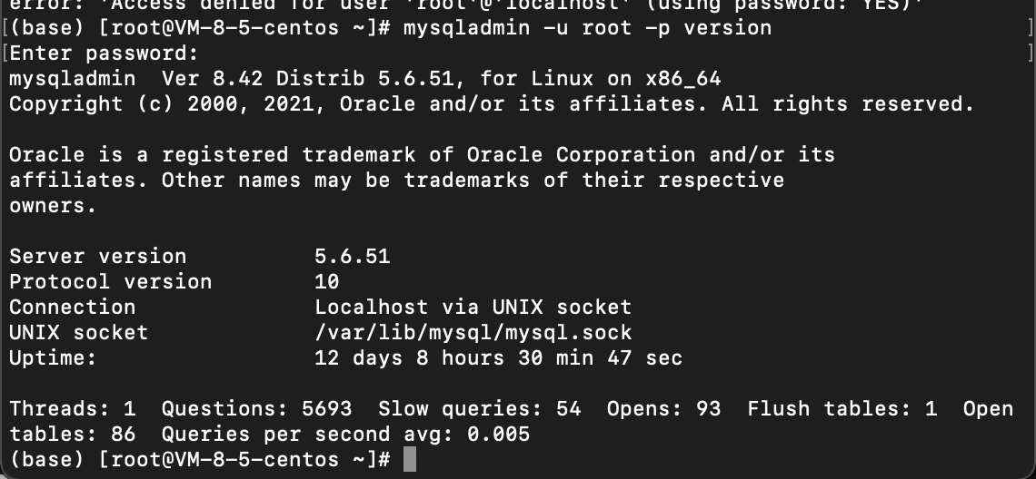
Database Server Building
Step 3 — Testing MySQL
We can verify our installation and get information about it by connecting with the mysqladmin tool, a client that lets you run administrative commands. Use the following command to connect to MySQL as root (-u root), prompt for a password (-p), and return the version.
mysqladmin -u root -p version
This indicates your installation has been successful.

Slide 20
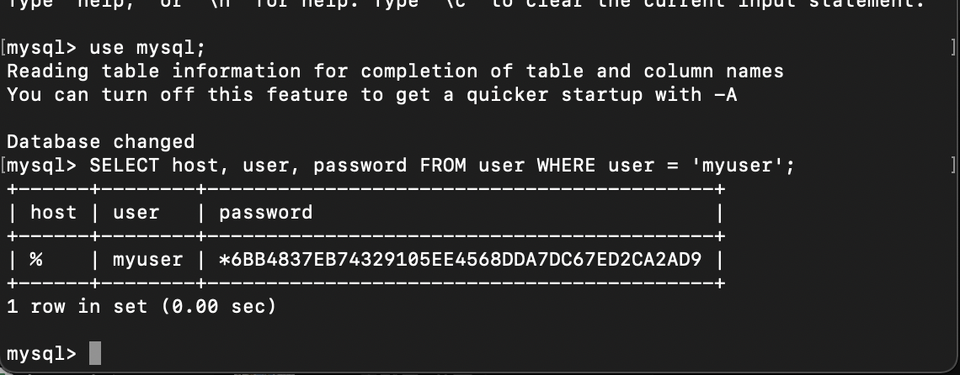
Database Server Building
Step 4. MySQL user settings
We need to add a MySQL user, just add a new user in the user table in the mysql database.
The following is an example of adding a user, the user name is myuser, the password is guest123, and the authorized user can perform SELECT, INSERT and UPDATE operation permissions:
root@host# mysql -u root -p
Enter password:*******
mysql> use mysql;
Database changed
mysql> INSERT INTO user
(host, user, password,
select_priv, insert_priv, update_priv)
VALUES ('%', 'myuser',
PASSWORD('123456'), 'Y', 'Y', 'Y');
Query OK, 1 row affected (0.20 sec)
mysql> FLUSH PRIVILEGES;
Query OK, 1 row affected (0.01 sec)
mysql> SELECT host, user, password FROM user WHERE user = 'myuser';
+------+--------+-------------------------------------------+
| host | user | password |
+------+--------+-------------------------------------------+
| % | myuser | *6BB4837EB74329105EE4568DDA7DC67ED2CA2AD9 |
+------+--------+-------------------------------------------+
1 row in set (0.00 sec)

Slide 21
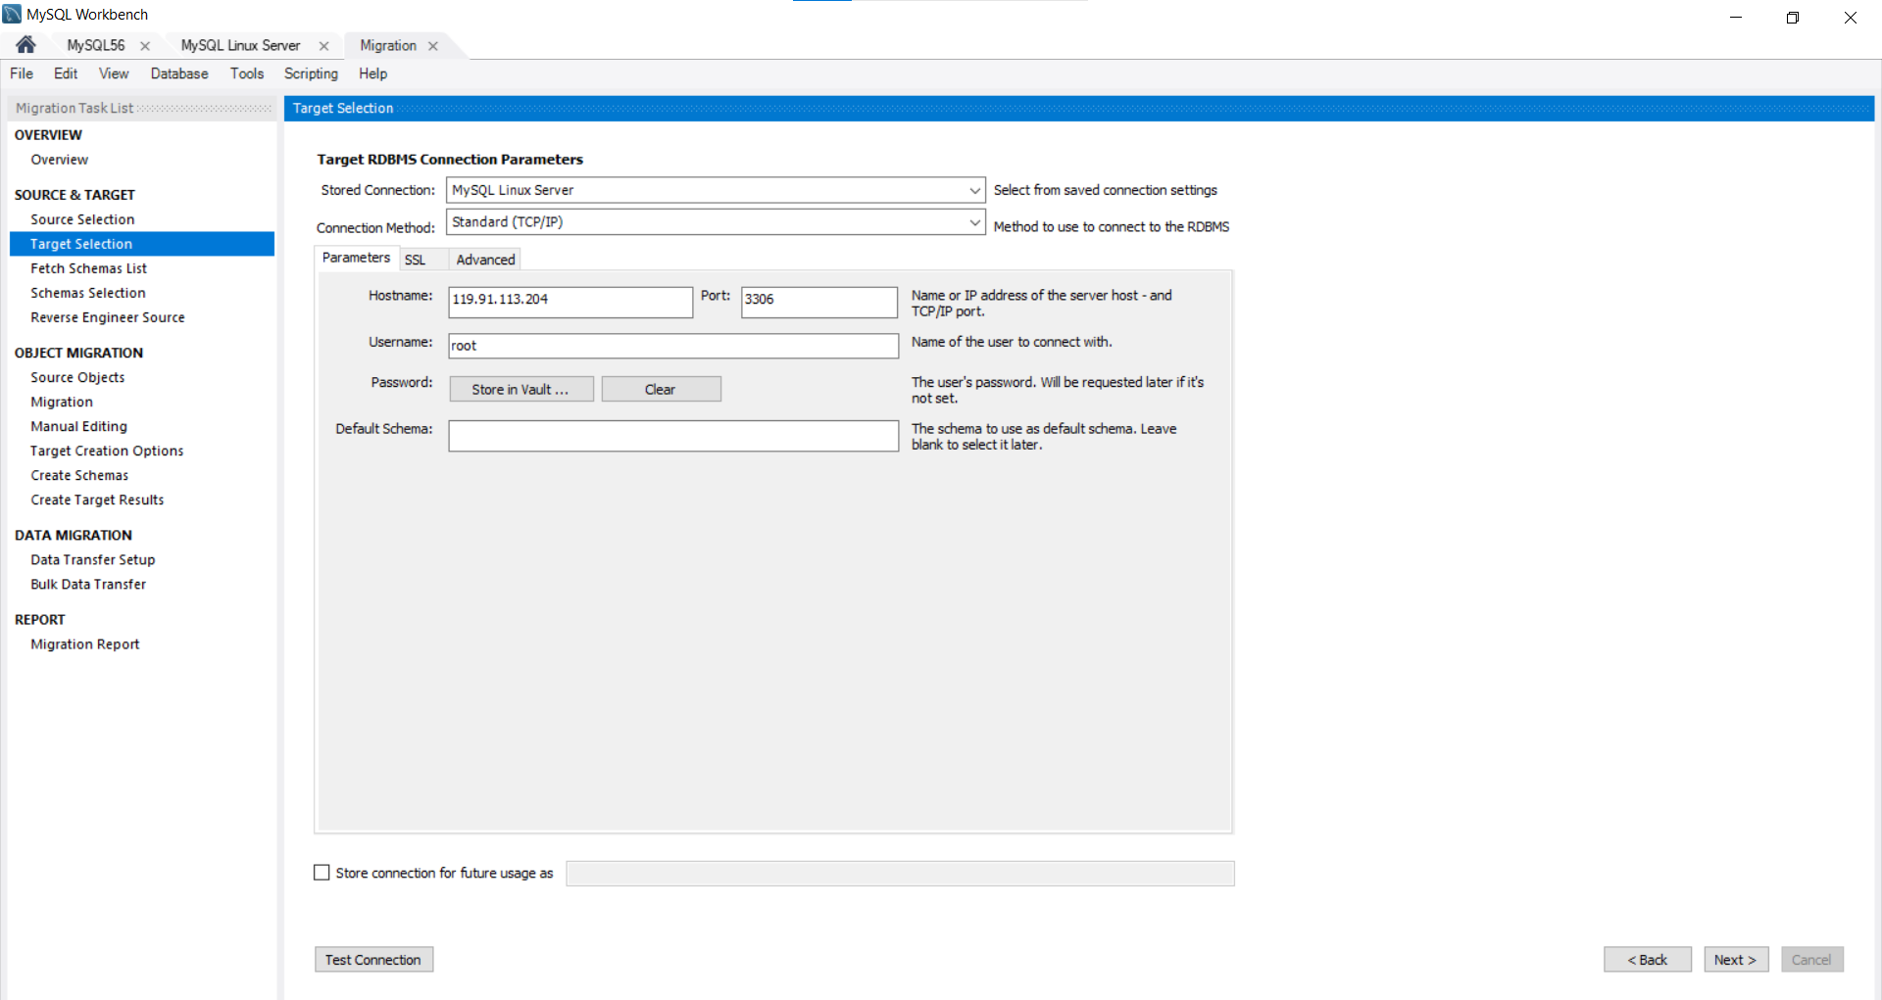
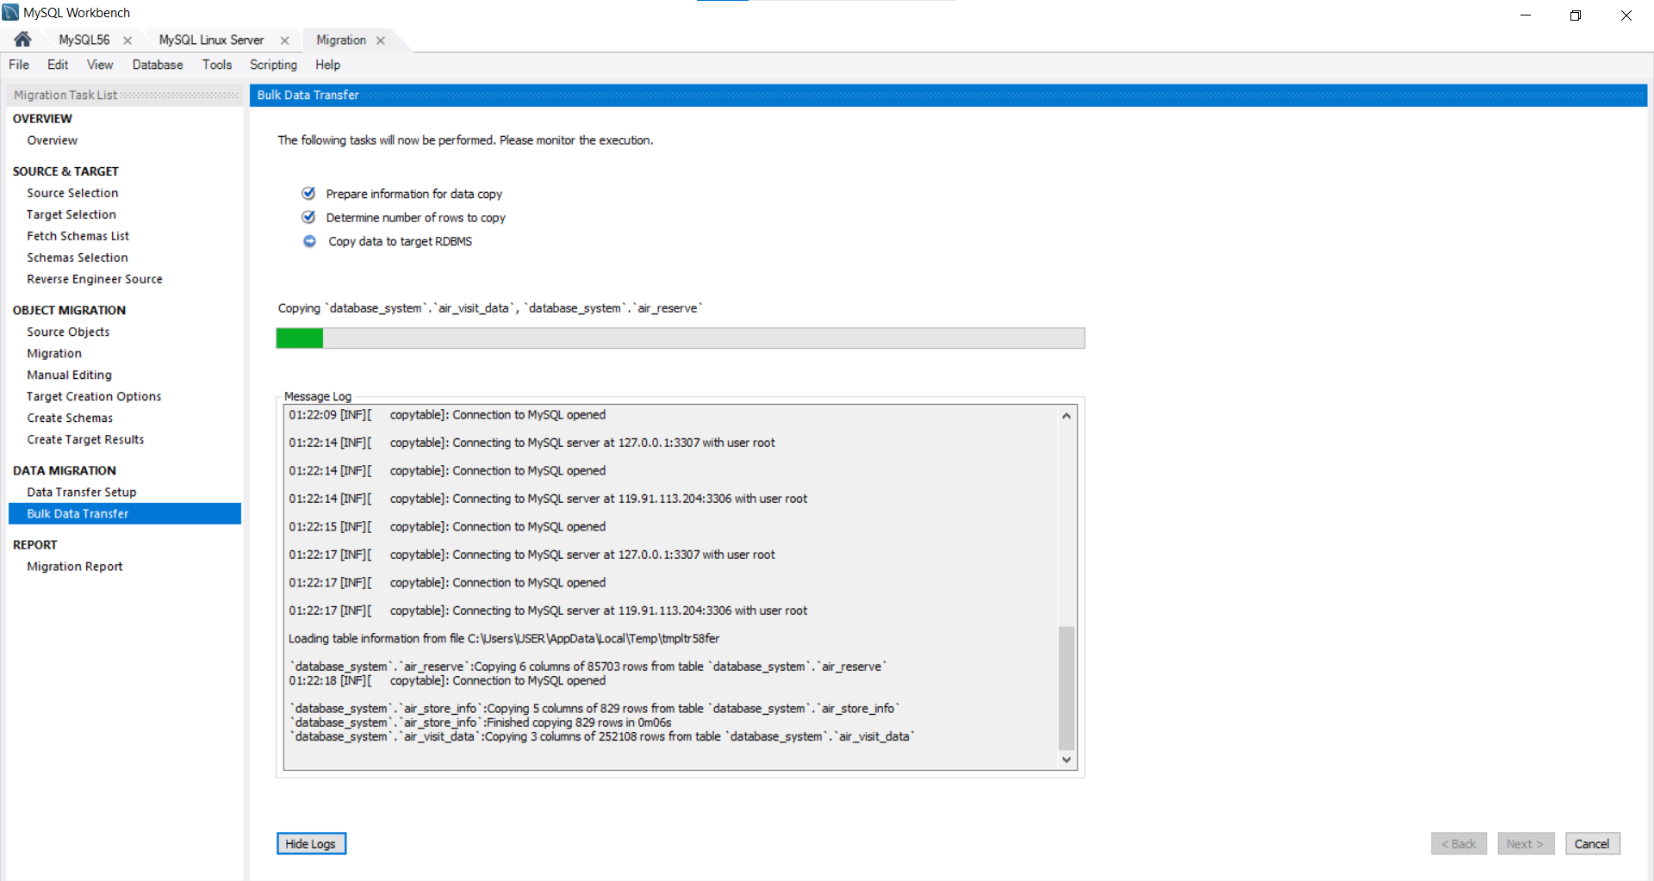
Data Migration
Then, we migrate our databases (including tables) to the MySQL Linux Server.
Notes:
贴上传的截图

Slide 22
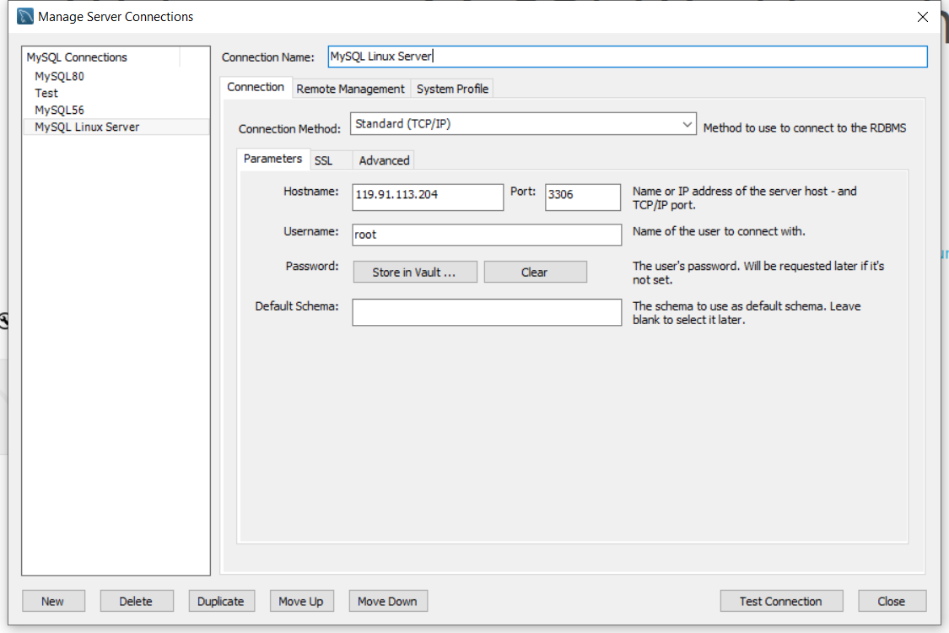
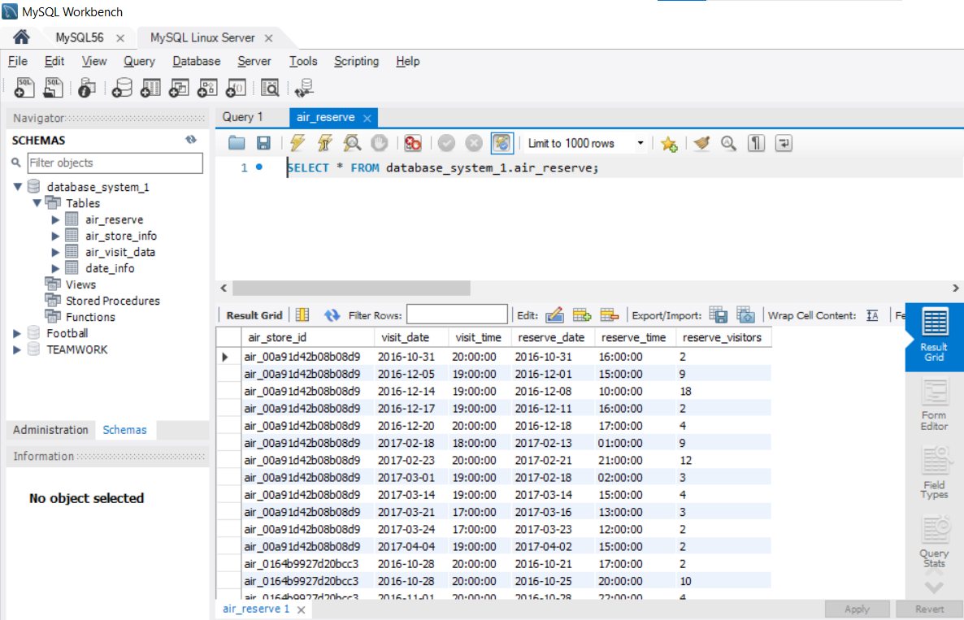
Retrieve Data From Server
Now, we can access the data from the server with any computer, it frees the constraint that the data can only be obtained from the local server.
Notes:
到时候贴从服务器获取数据的代码或截图

Slide 23
PART 2:
Data Visualization

Slide 24
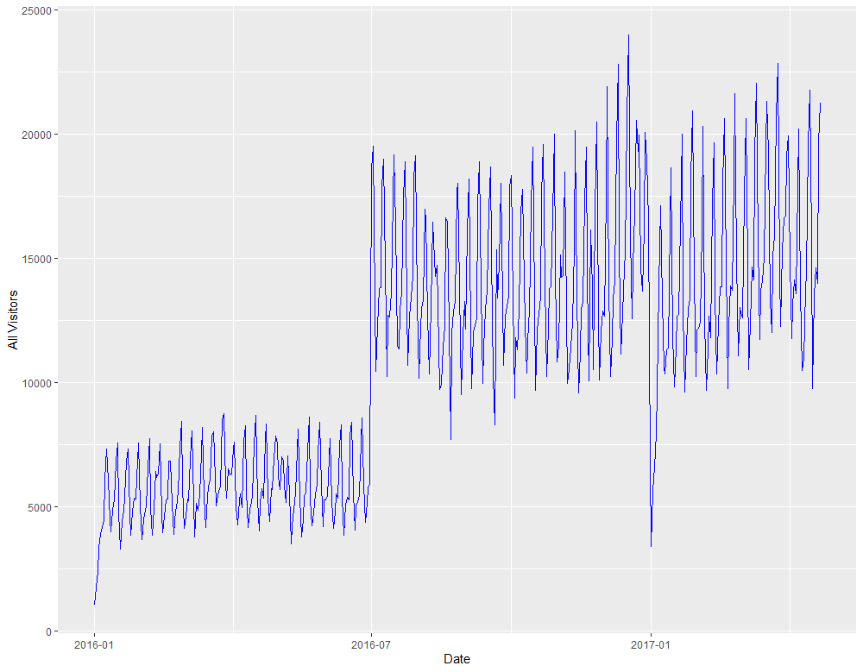
Data Visualization
The number of visitors in each day
We plot the total number of visitors per day over the full time range.
We find:
There is an interesting long-term step structure in the overall time series. This might be related to new restaurants being added to the data base.
In addition, we already see a periodic pattern that most likely corresponds to a weekly cycle.
Notes:
我们绘制了在整个时间范围内每天的游客总数
在整个时间序列中，有一个有趣的长期阶梯结构。这可能与新餐馆被添加到数据库中有关。
此外，我们已经看到一个周期性的模式，很可能与每周的周期相对应。

Slide 25
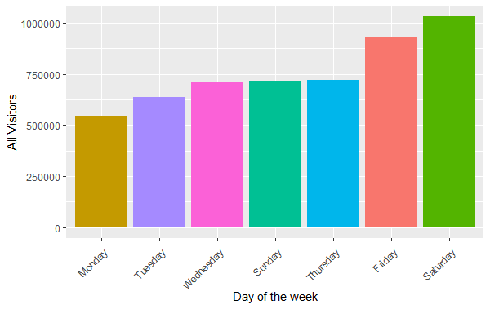
Data Visualization
The number of visitors from Monday to Sunday
We plot the total number of visitors per weekday and per weekend over the full time range.
We find:
Friday and Saturday appear to be the most popular days; which is to be expected. Sunday is not one of the popular days; which probably because the restaurant take a rest on Sunday.
Monday and Tuesday have the lowest numbers of average visitors.
Notes:
我们绘制了整个时间范围内每个工作日和每个周末的访客总数。
周五和周六似乎是最受欢迎的日子；这也是可以预期的。
周日不是最热门的，可能是因为餐厅休息。
周一和周二的平均访客数量最低。
。

Slide 26
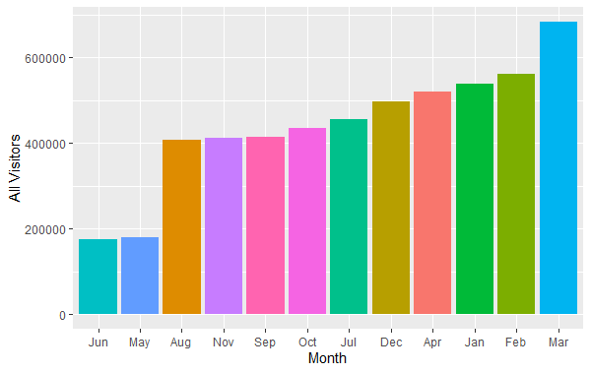
Data Visualization
The number of visitors on each month
We plot the total number of visitors per month over the full time range.
We find:
Also during the year there is a certain amount of variation.
The period of January - March is consistently busy.
June and July are the easiest months.
Personally, I think the popularity of the month is related to the holiday.
Notes:
我们绘制了整个时间范围内每个工作日和每个周末的访客总数。
1月至3月期间持续繁忙。
6-7月最闲
个人认为月份的热门与否和假期有关系

Slide 27
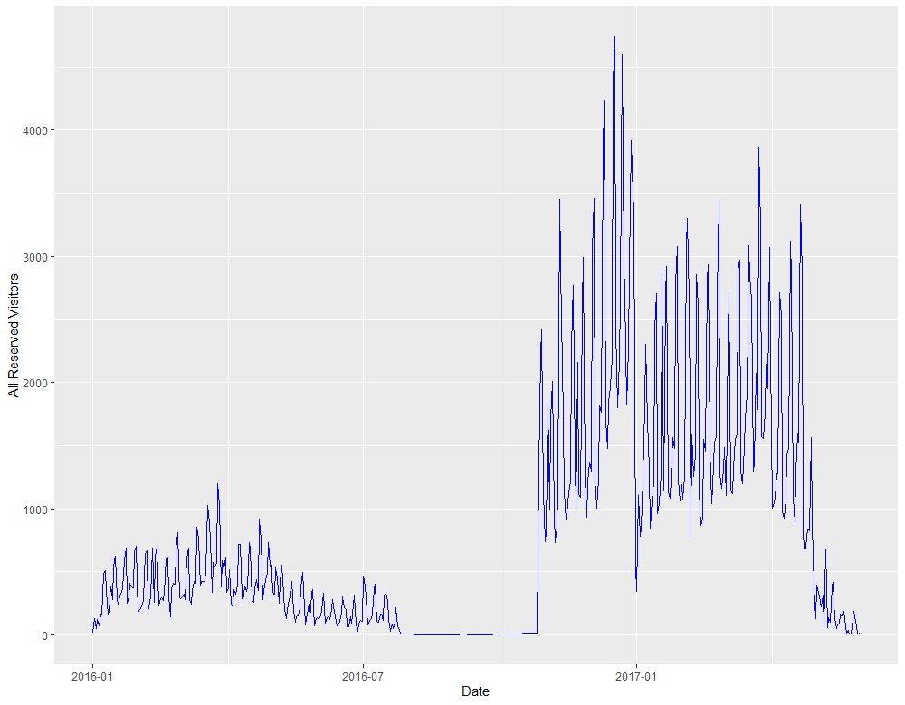
Data Visualization
The number of reserved visitors on each day
We plot the total number of reserved visitors per day over the full time range.
We find:
There were much fewer reservations made in 2016, even none for a long stretch of time (Personally, I think it's data loss).
In 2017 the visitor numbers stayed strong.
The great decline we see after the first quarter is most likely related to these reservations being at the end of the time frame, which means that long-term reservations would not be part of this data set.
Notes:
我们绘制了在整个时间范围内每天的预订游客总数。
2016年的预约量很少，甚至很长一段时间内都没有（个人认为是数据丢失）。
在2017年，游客数量保持强劲。
我们看到第一季度后的巨大下降，很可能与这些预订是在时间段的末尾有关，这意味着长期预订不会成为这个数据集的一部分。

Slide 28
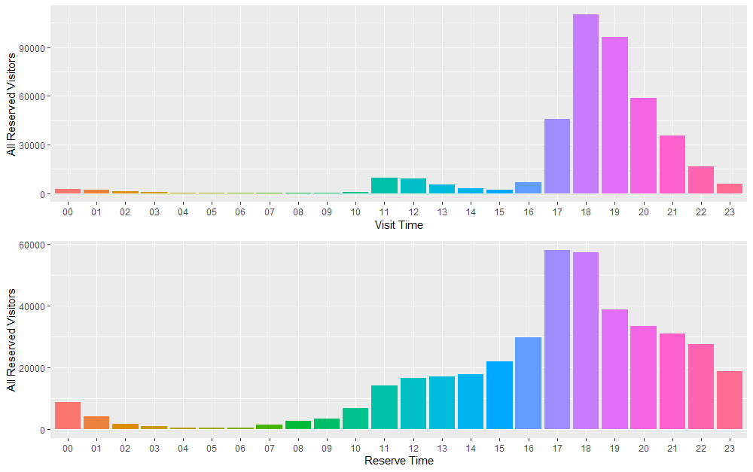
Data Visualization
The number of reserved visitors to visit restaurants on each hour
and
The number of reserved visitors to reserve on each hour
We plot the total number of reserved visitors to do the reservations and visit the restaurants the per hour over the full time range.
We find:
Reservations are made typically for the dinner hours in the evening.
The mealtime is about the same as the reserved time, which means that visitors usually make their next meal reservation at the mealtime
Notes:
我们绘制了在整个时间范围内每小时预订和访问餐厅的预约游客总数。
预约通常是在晚上的晚餐时间进行的。
就餐时间与预约时间差不多，这意味着游客通常在就餐时间进行下一次的预约

Slide 29
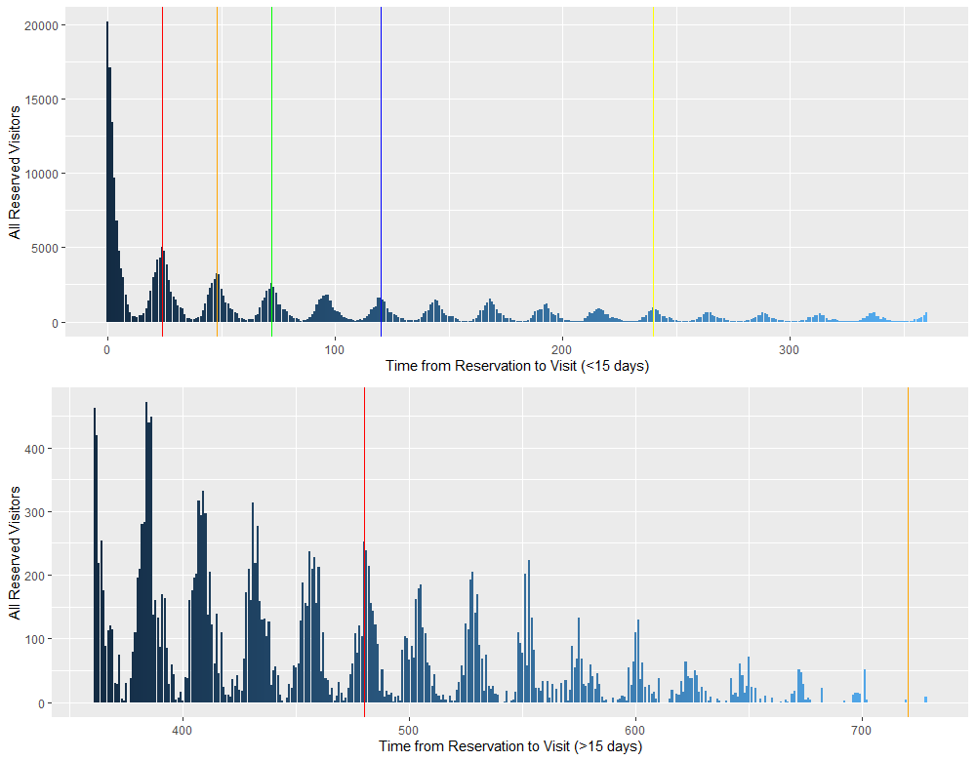
The difference(interval) between reserve time and actual visit time
Data Visualization
We plot the difference(interval) between reserve time and actual visit time within 15 days and over 15 days throughout the whole time range.
We find:
The time, here shown in hours, between making a reservation and visiting the restaurant follow a nice 24-hour pattern. The most popular strategy is to reserve a couple of hours before the visit, but if the reservation is made more in advance, then it seems to be common to book a table in the evening for one of the next evenings.
There are still many reservations for more than 15 days, but very few for more than two months.
Notes:
我们绘制了15天内和超过15天的整个时间范围内的预约时间和实际访问时间之间的差异（间隔）。
这里以小时为单位显示，从预订到访问餐厅之间的时间遵循一个漂亮的24小时模式。最流行的策略是在访问前几个小时预订，但如果预订的时间更早，那么在晚上预订下一个晚上的桌子似乎很常见。
超过15天的预定依旧有很多，但是超过两个月的预定就很少了，这也印证了之前说的长预约不在数据集中

Slide 30
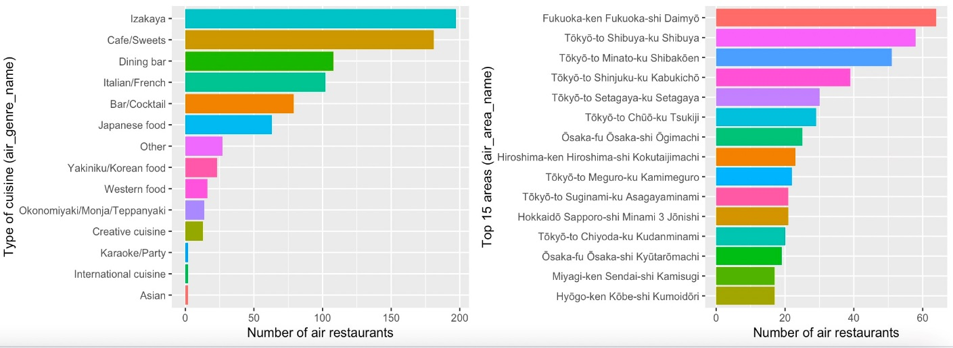
The popular list of different types of Restaurant
and
The popular list of different areas
Data Visualization
We find:
There are lots of Izakaya and Cafe.
Fukuoka has the largest number of air restaurants per area, followed by many many Tokyo areas!
Notes:
我们画出不同类型的菜肴和拥有最多餐厅的地区。
有很多居酒屋，其次是咖啡馆
福冈地区的餐厅数量最多，其次是很多很多东京地区。

Slide 31
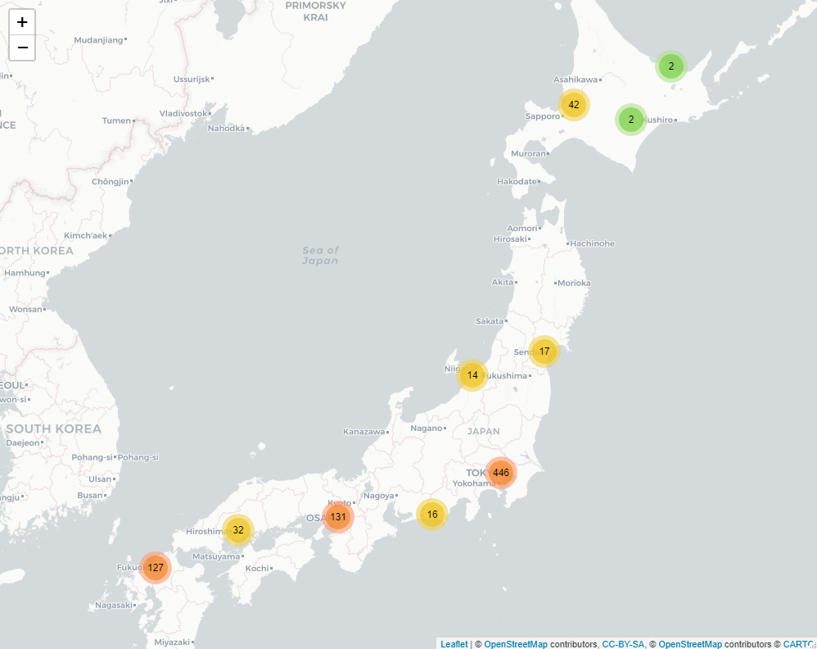
Data Visualization
The Map of all restaurants' location (Dynamic)

Slide 32
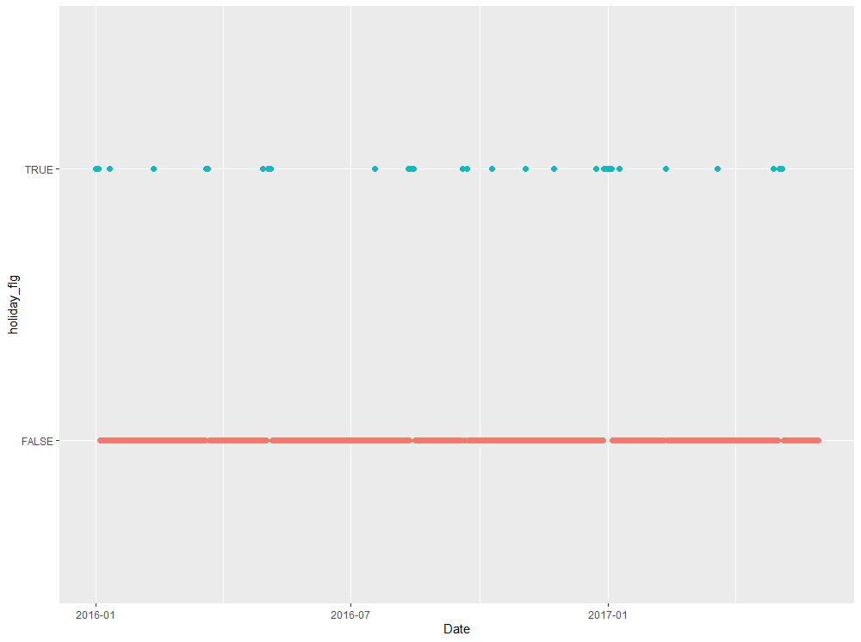
Data Visualization
Holiday Distribution (All Time)
We plot how many there are in total and how they are distributed throughout the whole time range.
We find:
The same days were holidays from January to May in 2016 as in 2017.
There are about 7% holidays in our data.
Notes:
我们绘制了假期一共有多少个，以及它们在整个时间范围内的分布情况。
2016年1月至5月的假期与2017年相同。
我们的数据中大约有7%的假期。

Slide 33
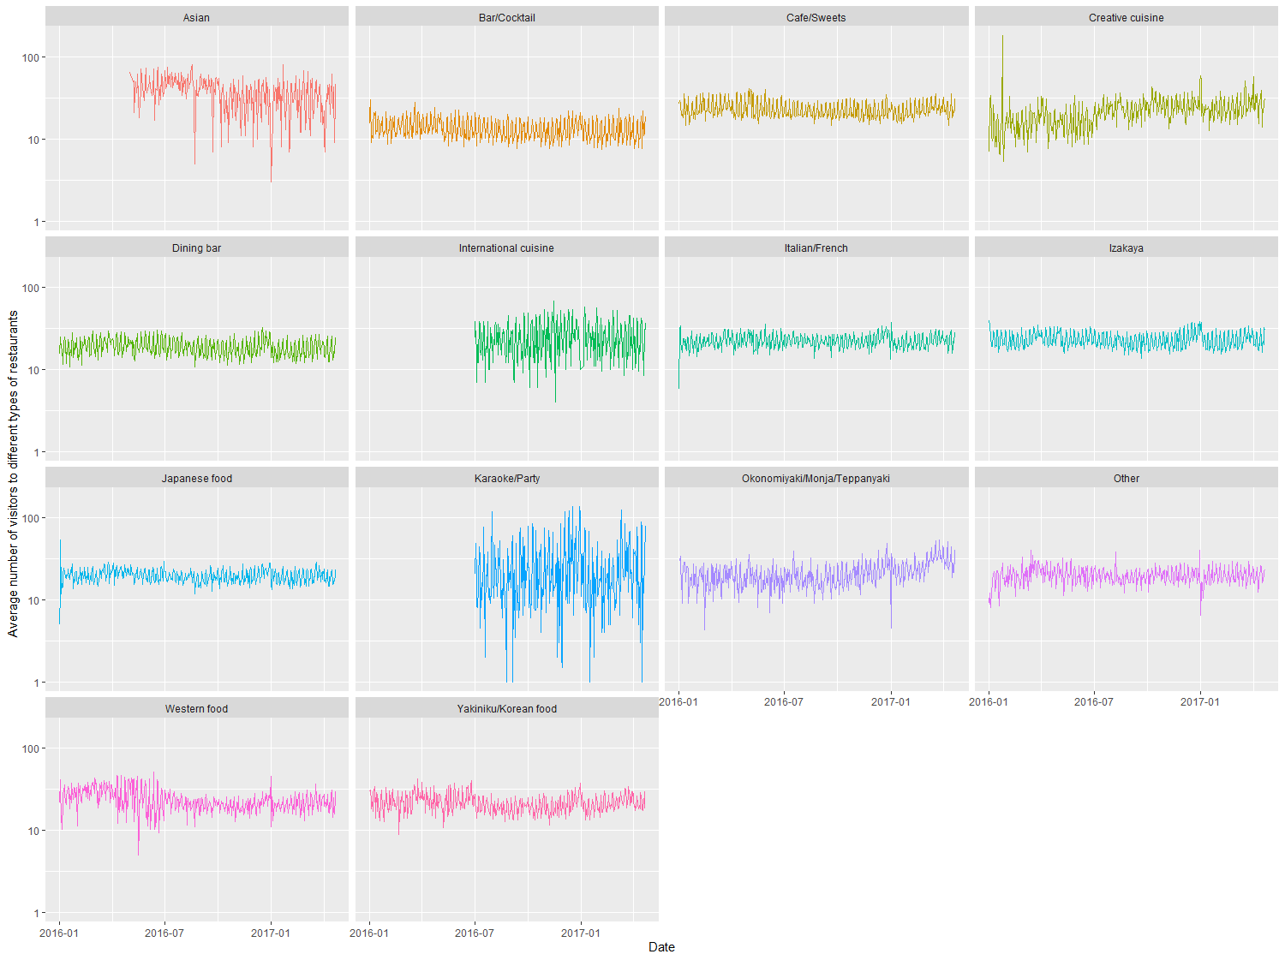
The Average number of visitors to different types of restaurants on each day
Data Visualization
Our first plot of the multi-feature space deals with the average number of air restaurant visitors with different types of restaurant. We use a facet plot to distinguish the types of restaurant for the 14 categories.
We find:
The mean values range between 10 and 100 visitors per genre per day. Within each category, the long-term trend looks reasonably stable.
There is an upward trend for “Creative Cuisine” and “Okonomiyaki”. while the popularity of “Asian” food has been declining since late 2016.
Notes:
我们的第一个多特征空间图涉及到不同类型餐厅的平均游客数量。我们用一个面图来区分14个类别的餐厅类型。
平均值在每个流派每天10到100个游客之间。在每个类别中，长期趋势看起来相当稳定。
创意美食 "和 "御好烧 "有上升的趋势。而 "亚洲 "食品的受欢迎程度自2016年底以来一直在下降。

Slide 34
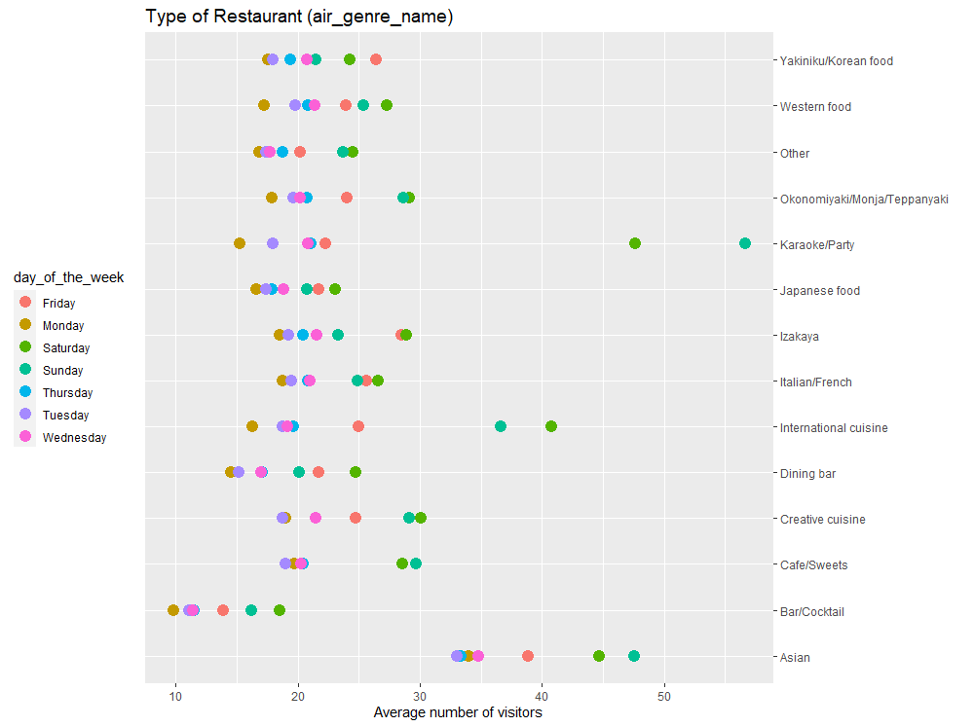
For different types of restaurants, WHEN do the visitors like to go
Data Visualization
Greenish is the weekend.
We find:
The biggest difference between weekend and weekdays exists for the “Karaoke” bars, which rule the weekend. Similarity, the “International” cuisine also rule the weekend.
No genre really goes against the trend of busier weekends. The smallest variations are in the generic “Other” category, the “Japanese” food, and the “Korean” which is the only category where Fridays are the busiest days.
“Bars/Cocktail” are notably unpopular overall.
Notes:
周末和工作日的最大区别存在于 "卡拉OK "酒吧，它们统治着周末。相似的是，"国际 "美食也统治了周末。
没有一个流派真正违背了周末更繁忙的趋势。最小的变化是在一般的 "其他 "类别，"日本 "食品，以及 "韩国 "美食，这是唯一的类别，周五是最繁忙的日子。
一般的 "酒吧/鸡尾酒 "在整体上明显不受欢迎。

Slide 35
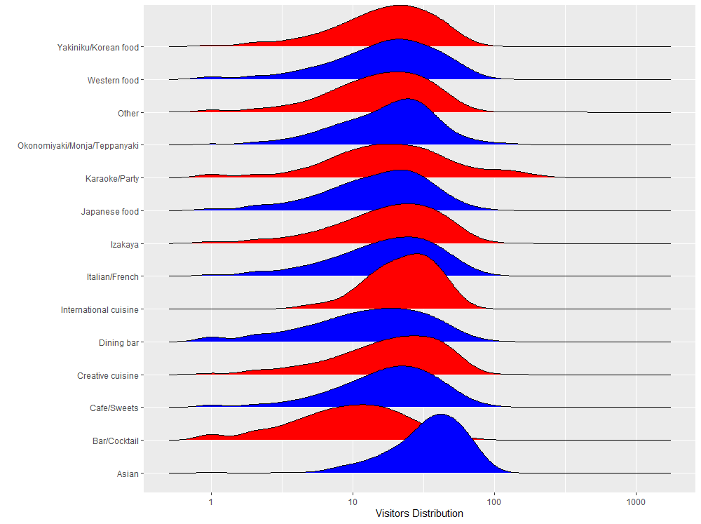
For different types of restaurants, HOW MANY people usually go together
Data Visualization
We find:
The density curves confirm the impression we got from the week-day distribution:
the “Asian” restaurants have rarely less than 10 visitors per date
the “Karaoke” places show a very broad distribution due to the strong impact of the weekends.
Notes:
亚洲 "餐厅的访客很少少于10人。
由于周末的强烈影响，"卡拉OK "场所显示出非常广泛的分布。

Slide 36
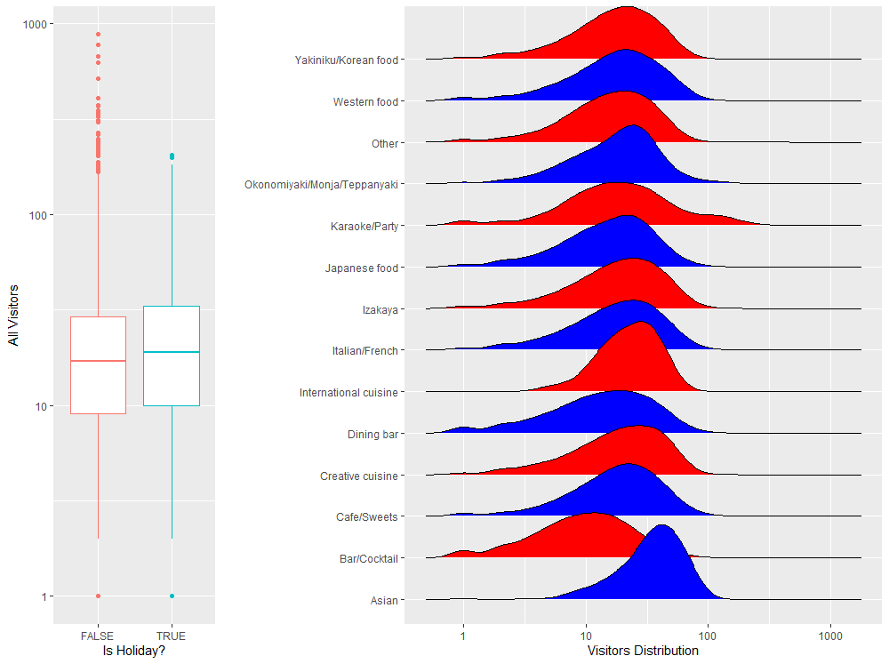
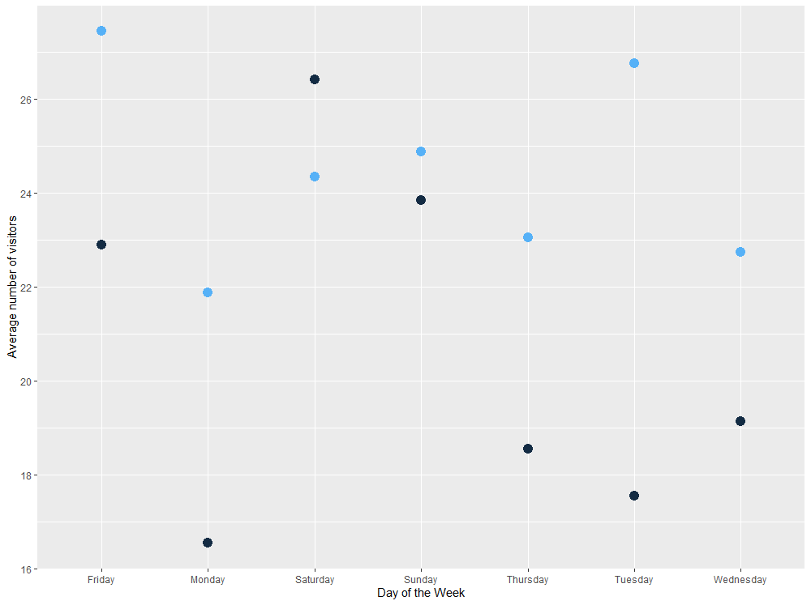
The impact of holidays
Data Visualization
We will study the influence of holidays on our visitor numbers by comparing the statistics for days with holidays vs those without holiday flag:
We find:
Overall, holidays don’t have any impact on the average visitor numbers (left panel).
For weekend, holiday has little impact on the visitor numbers.
holiday has much more effect for the weekdays; especially Monday and Tuesday.
Notes:
我们将通过比较有假期的日子与没有假期标志的日子的统计数字来研究假期对我们的游客数量的影响。
总的来说，假期对平均访客数量没有任何影响（左图）。就像很多时候一样，更多的信息隐藏在细节中。
虽然周末的假期对游客人数影响不大，甚至略有减少，但对工作日有更明显的影响；特别是周一和周二（右图）。

Slide 37
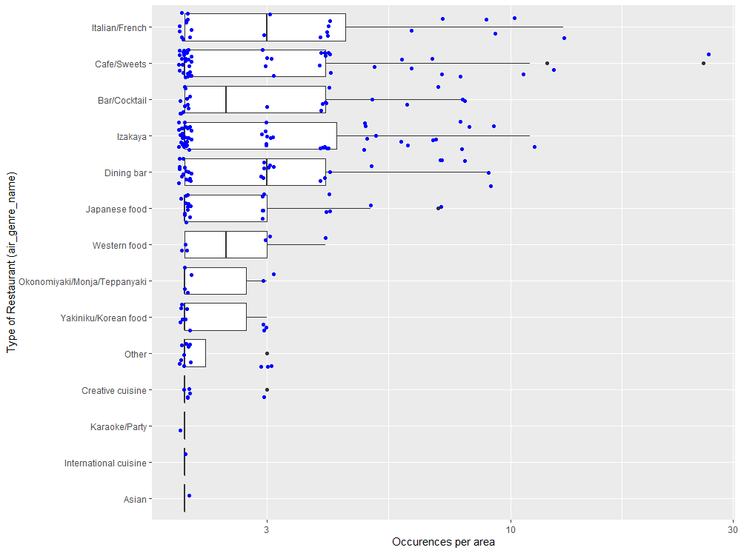
For different types of restaurant and different types of areas, the distribution of visitors
Data Visualization
We find:
Only few types of restaurants have medians of more than 2 restaurants per area. Like: “Italian/French” restaurants or “Bar/Cocktail” places
“Cafes” have the highest number with 26 occurences in a single area (Fukuoka-ken Fukuoka-shi Daimyō).
Notes:
只有少数类型的餐馆的中位数超过了每个地区的2家餐馆。比如。"意大利/法国 "餐馆或 "酒吧/鸡尾酒 "场所
"咖啡馆 "的数量最多，在一个地区（福冈县福冈市大名）出现了26次。

Slide 38
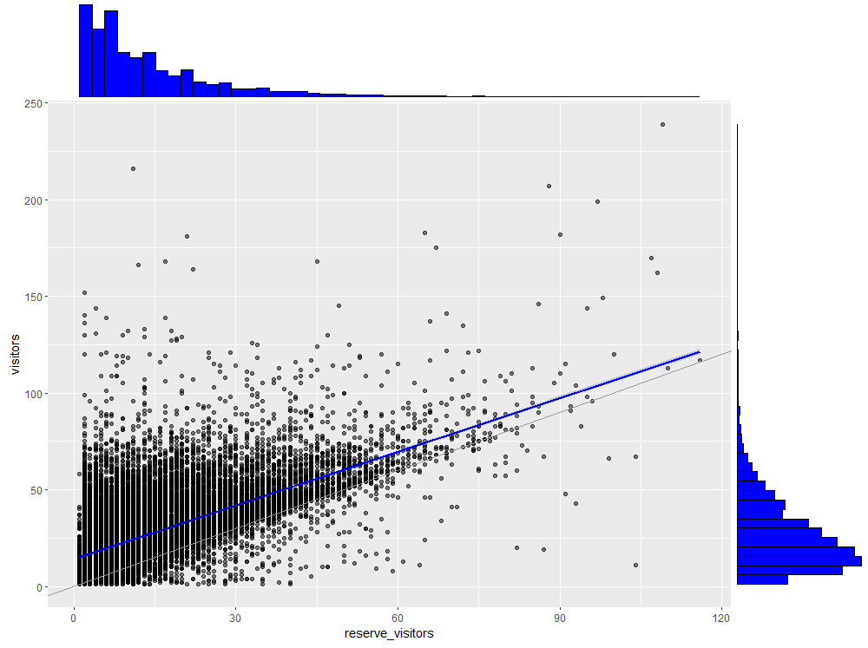
The relationship between reserved visitors and non-reserved visitors (visitors) on each day
Data Visualization
we plot the total reserve_visitor numbers against the actual visitor numbers for the air restaurants.
We find:
The histograms show that the reserve_visitors and visitors numbers peak below ~20 and are largely confined to the range below 100.
The scatter points fall largely above the line of identity, indicating that there were more visitors than reserved visitors on one day. This is not surprising, from my perspective, since a certain number of people will always be walk-in customers.
Notes:
我们将总的预订游客数与实际游客数进行对比。
直方图显示，预留游客和游客数量在~20以下达到峰值，并在很大程度上局限于100以下的范围。
散点在很大程度上落在特征线之上，表明在某一天有更多的游客比预约游客多。这并不奇怪，因为总是有一定数量的人是走访的顾客。

Slide 39
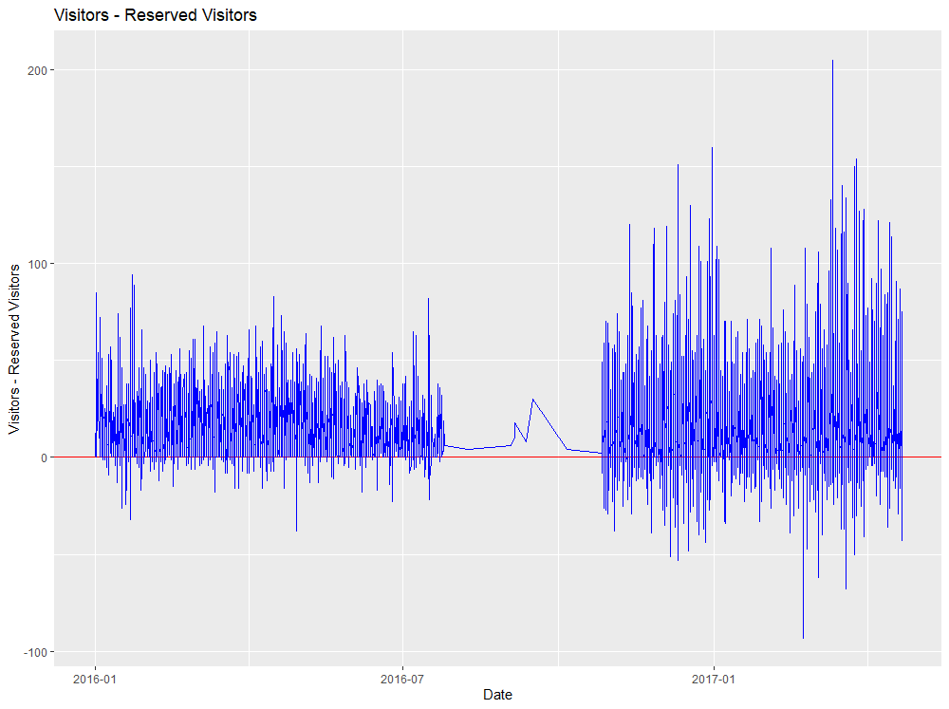
The difference between reserved visitors and non-reserved visitors (visitors) on each day
Data Visualization
We find:
While the curves are predominantly above the baseline (i.e. more visitors than reservations),
Notes:
曲线主要是在基线之上（即访客多于预订）。

Slide 40
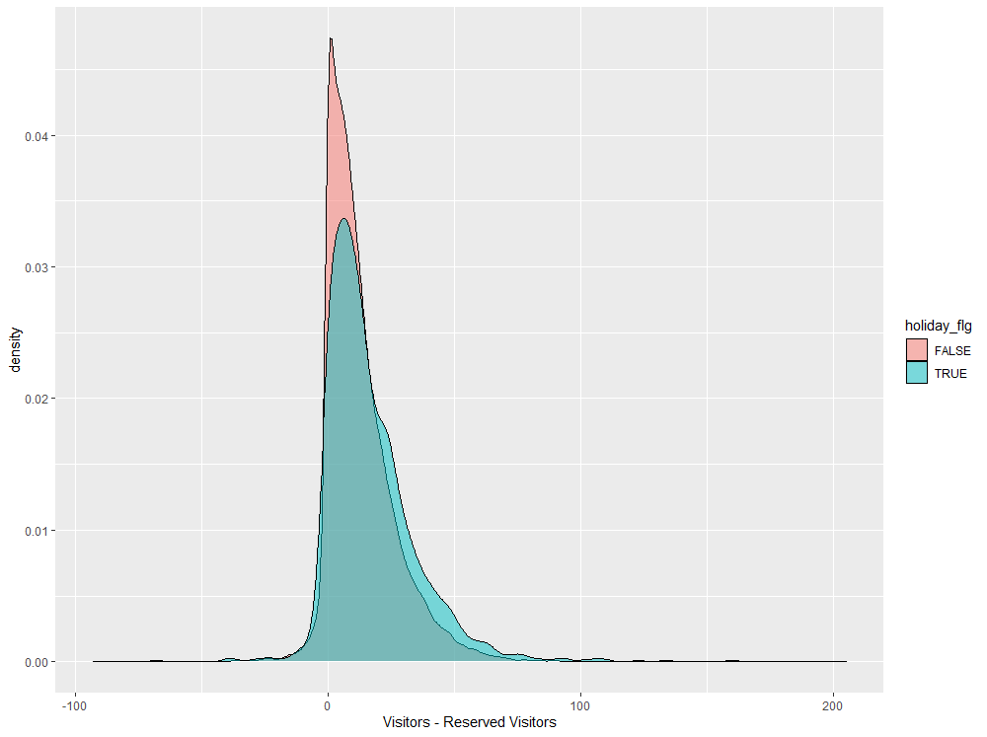
The density difference between reserved visitors and non-reserved visitors (visitors) on each day whether it is holiday or not
Data Visualization
Finally, let’s have a quick look at the impact of holidays on the discrepancy between reservations and visitors.
We find:
On holiday, there are somewhat higher numbers of visitors compared to reservations.
Notes:
最后，让我们快速看一下假期对预订和访客之间差异的影响。
与节假日的预订相比，游客的数量要多一些。峰值几乎是相同的，但我们看到小而明显的差异，朝着更大的数字。

Slide 41
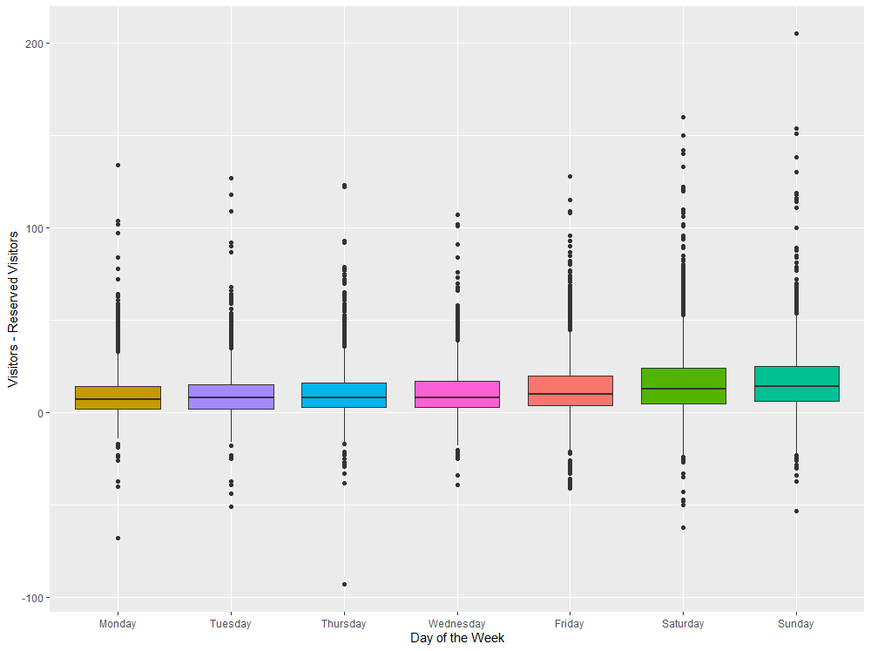
The difference between reserved visitors and non-reserved visitors (visitors) on each day of the week (shown by boxplot)
Data Visualization
We find:
We find that there is no significant difference
although we see a slight trend for more visitors compared to reservations on the weekend, especially Sunday.
Notes:
我们发现没有明显的差异，尽管我们看到在周末，特别是周日，与预订相比，有更多的游客的轻微趋势。

Slide 42
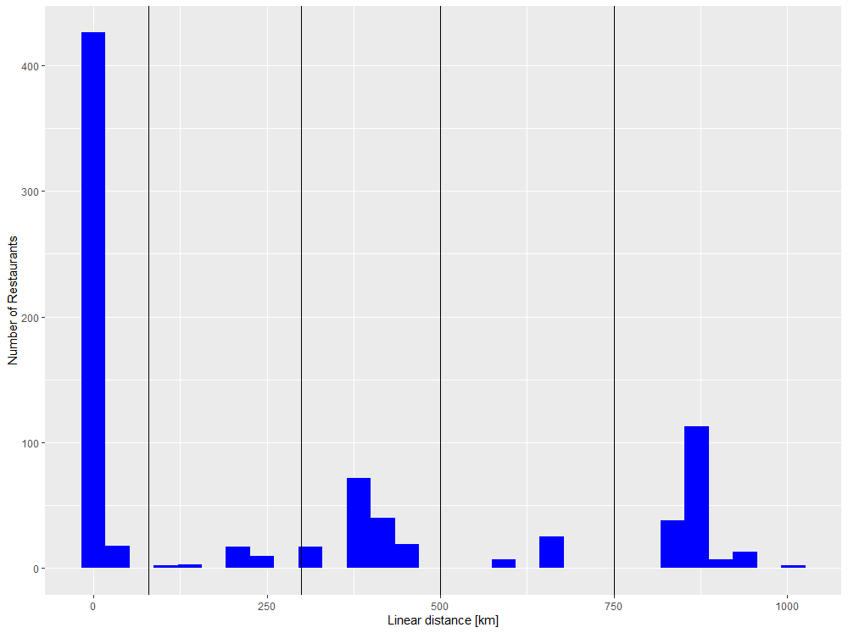
Data Visualization
The distance from the busiest area
As the single reference point for all distances, we choose the median latitude and median longitude.
We find:
The distance distribution has a clear peak at very short values; which is to be expected since our reference is the median.
We also see further peaks, most prominently around ~450 km and ~800 km. These will correspond to (groups of) cities.
Notes:
作为所有距离的单一参考点，我们选择纬度中值和经度中值。
距离分布在很短的数值上有一个明显的峰值；这是可以预期的，因为我们的参考是中位数。
我们还看到更多的峰值，最突出的是在~450公里和~800公里附近。这些将对应于（一组）城市。

Slide 43
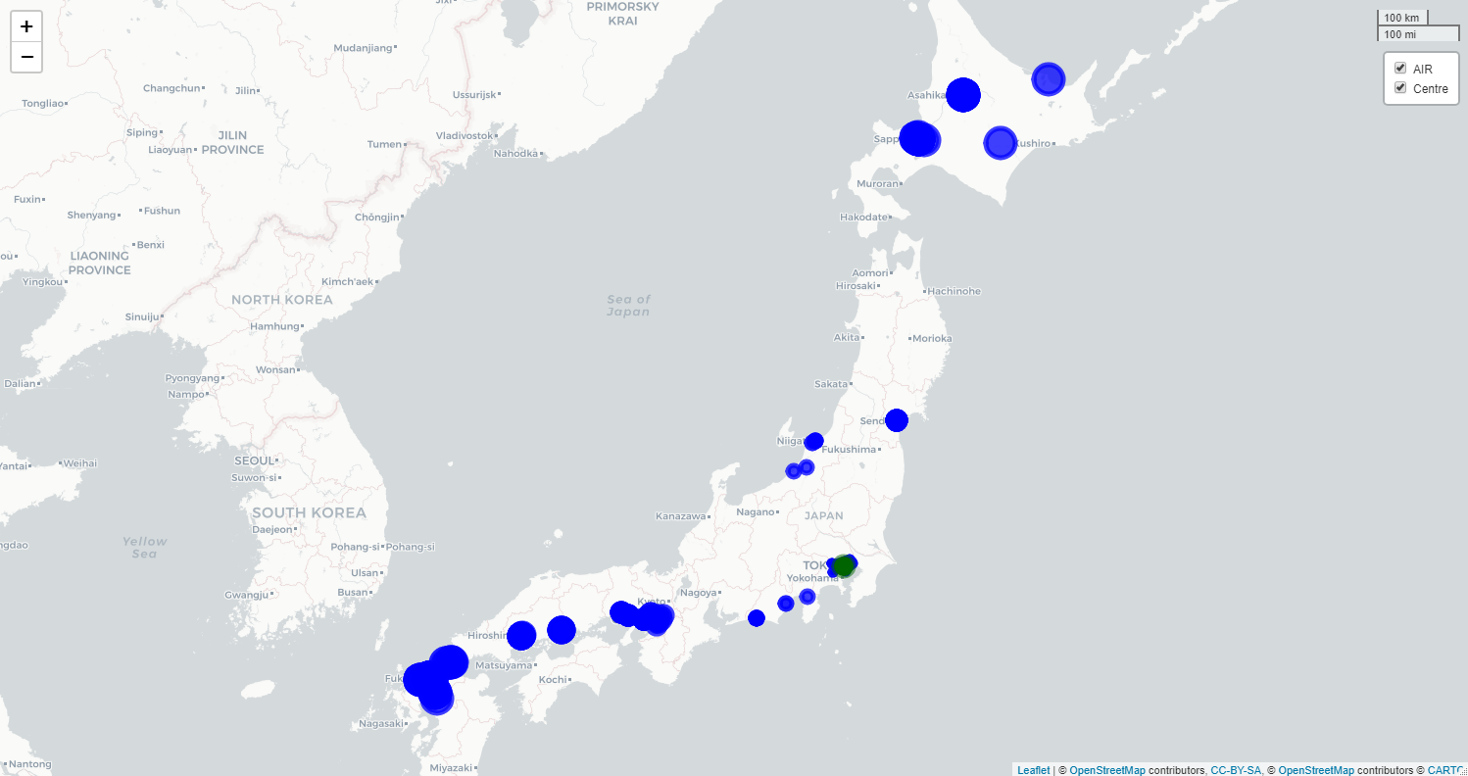
Data Visualization
The distribution of Restaurants (After Clustering)

Slide 44
PART 3:
Time Series Analysis

Slide 45



Time Series Model
ARIMA is actually a class of models that explains a given time series based on its own past values, so that equation can be used to forecast future values. Any ‘non-seasonal’ time series that exhibits patterns and is not a random white noise can be modeled with ARIMA models.
ARIMA
Prophet
To alleviate this supply gap and to make scalable forecasting dramatically easier, the Core Data Science team at Facebook created Prophet, a forecasting library for Python and R, which they open-sourced in 2017.
Holt Winters
This method uses exponential smoothing to combine current information and past information. The weight of the old and new information is controlled by an adjustable parameter.

Slide 46
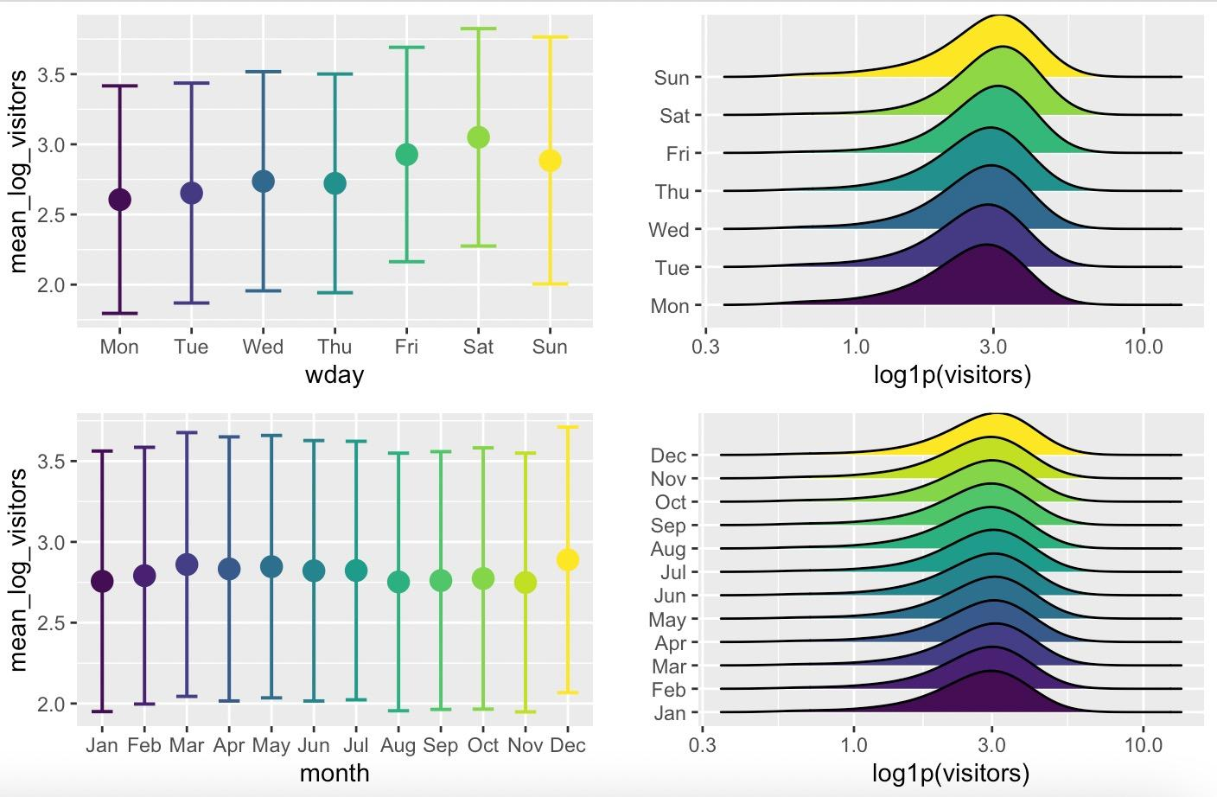
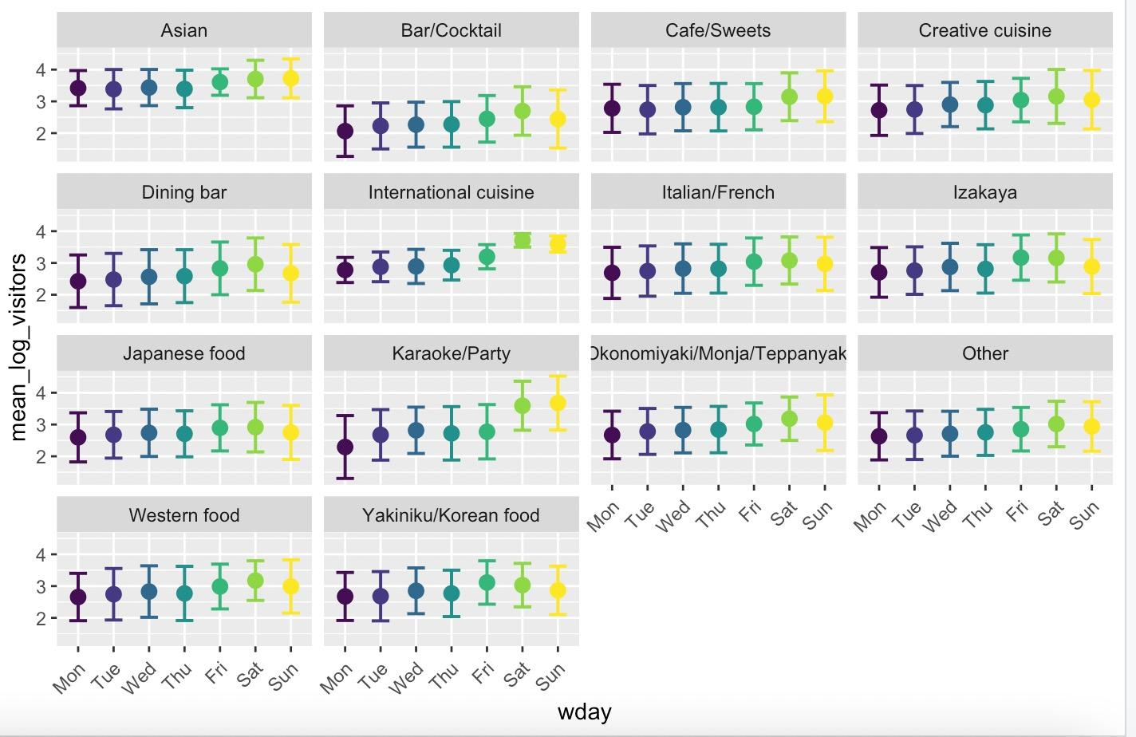
Feature Engineering
Deriving new features from the existing ones can provide additional predictive power for our goal to forecast visitor numbers.
Days of the week & months of the year
Restaurant per area - air_count
Distance from the busiest area
Prefectures
Time series parameter：mean, standard deviation, slope, and slope error of the time series

Slide 47



Model Demonstration
ARIMA (p, q ,d)
The number of times the difference operation is performed will be determined as the d value.
use the data and parameter values we calculated in the previous steps to fit the ARIMA model.
Time series stationary
Determine p and q
Fit the ARIMA model
Predict future values
Determine D
This includes checking the stationarity of the series and performing the required transformations.
Make predictions on the validation set.
read the value of p and q from the ACF and PACF diagrams.

Slide 48
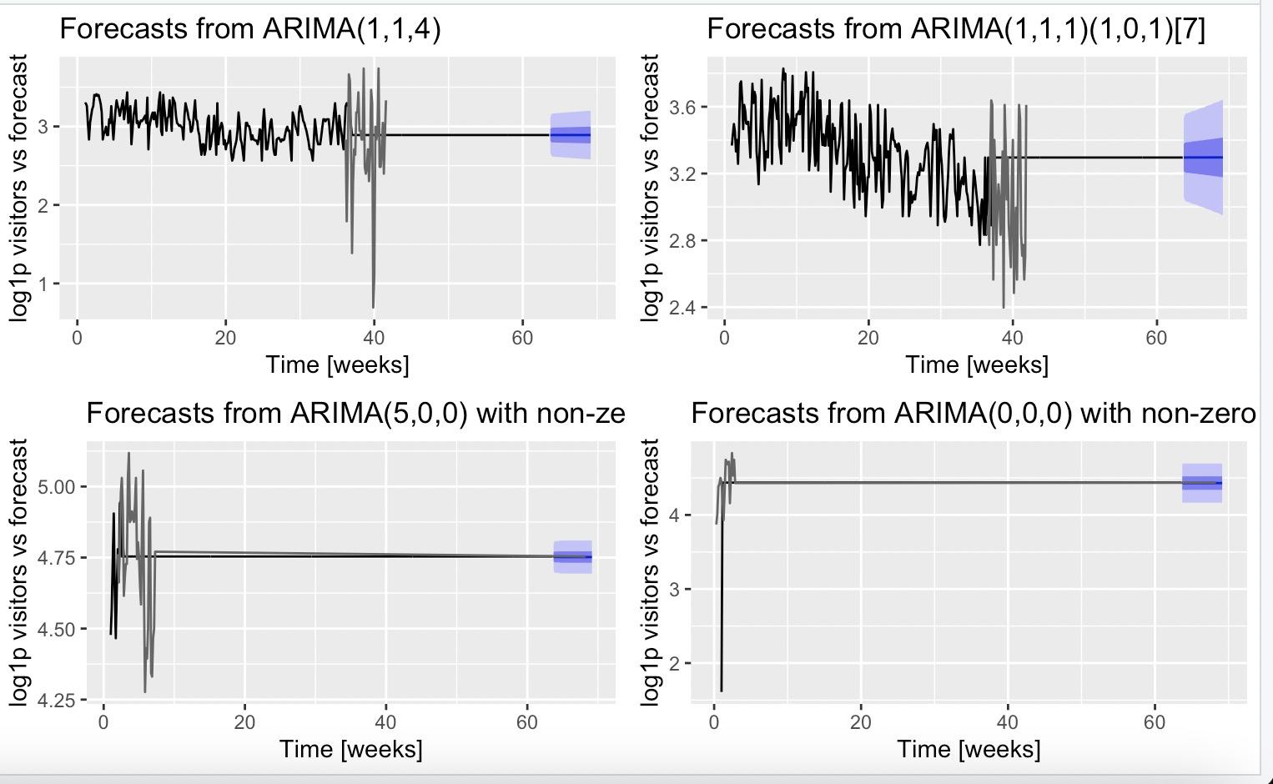
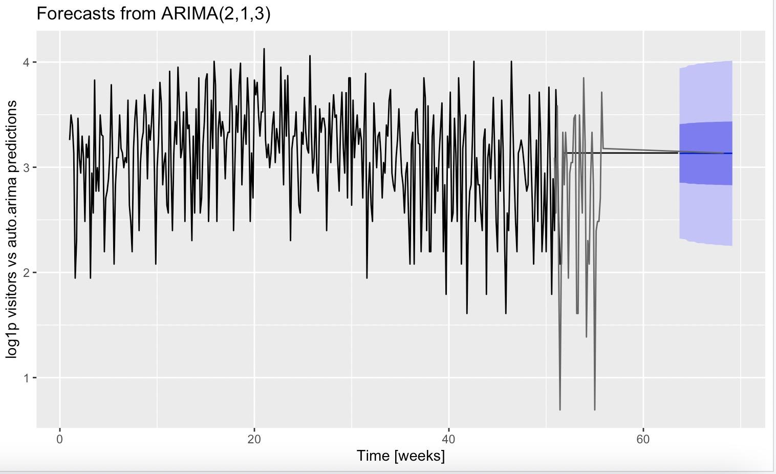
Model Demonstration
Result of ARIMA (p, q ,d)
Overall, the results are not great, but given that it’s a fully automatic forecast (assuming only weekly periodicities) the auto. Arima tool gives us a first baseline to compare other methods to.

Slide 49



Model Demonstration
Prophet
Building on work based on ARIMA section. Creating a training and validation set for the same periods as above but not replace NA value.
Prophet utilizes an additive regression model which decomposes a time series into:
(i) a (piecewise) linear/logistic trend,
(ii) a yearly seasonal component,
(iii) a weekly seasonal component
(iv) an optional list of important days (such as holidays)
It claims to be “robust to missing data, shifts in the trend, and large outliers”. Especially the missing data functionality could be useful in this competition.
Prophet expects a data frame with two columns: ds for the dates and y for the time series variable.
The parameter changepoint-prior-scale adjusts the trend flexibility. The parameter yearly. Seasonality has to be enabled/disabled explicitly and allows prophet to notice large-scale cycles. We have barely a year of data here.

Slide 50
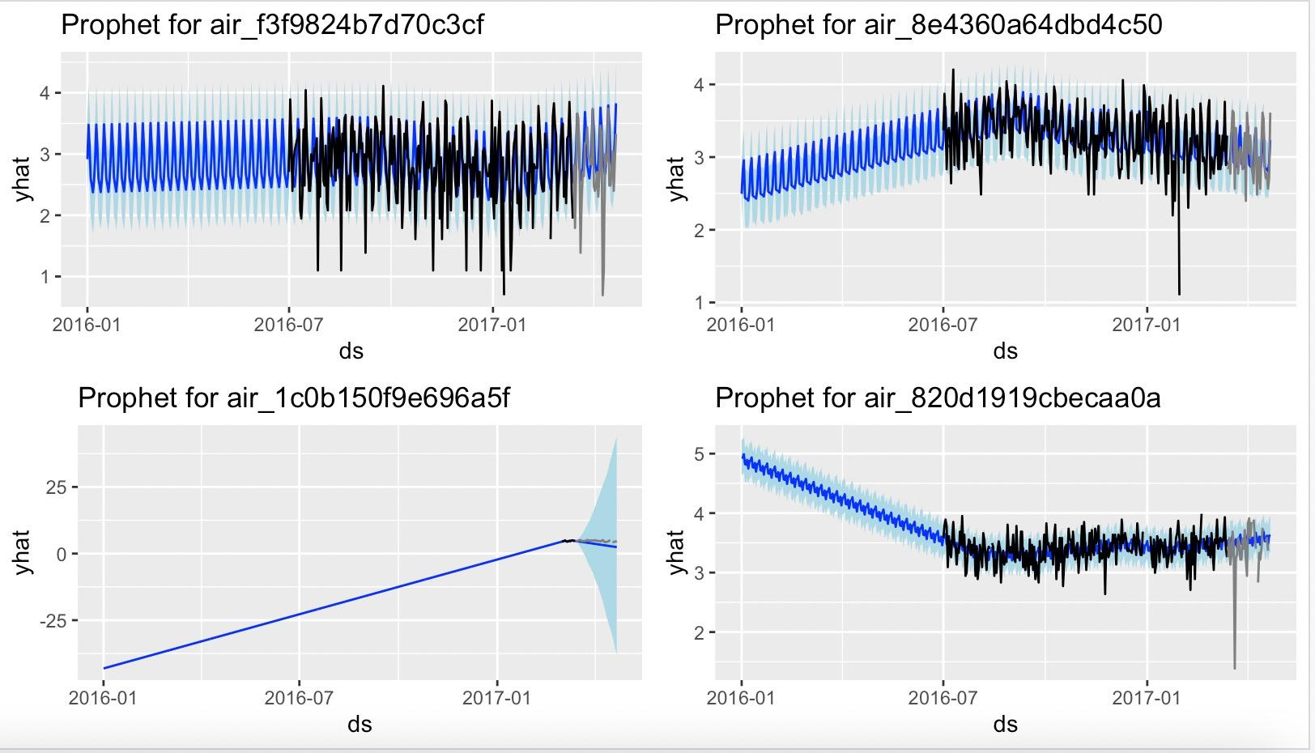
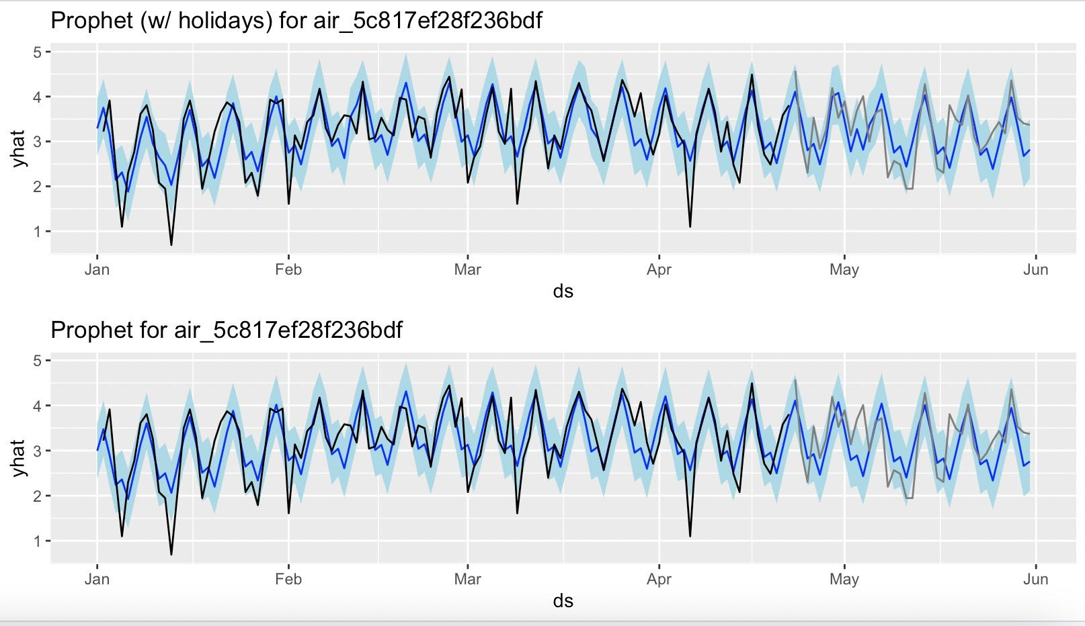
Model Demonstration
Result of Prophet
Plotting training visitor counts in black, the validation set in grey, and the forecast plus uncertainties in blue and light blue.
Prophet also gives us the possibility to include holidays and other special events in our forecast, which is very useful in taking the Golden Week into account.
Finding that overestimating the trend component could probably result in less flexibility. The forth time series has too little data for prophet to do much. Here we could discard the trend component completely or simply take the median.
We may see that there is a subtle improvement in fitting the Golden Week visitors when including holidays. The performance of this component might improve if there are more holidays included in the training set.

Slide 51
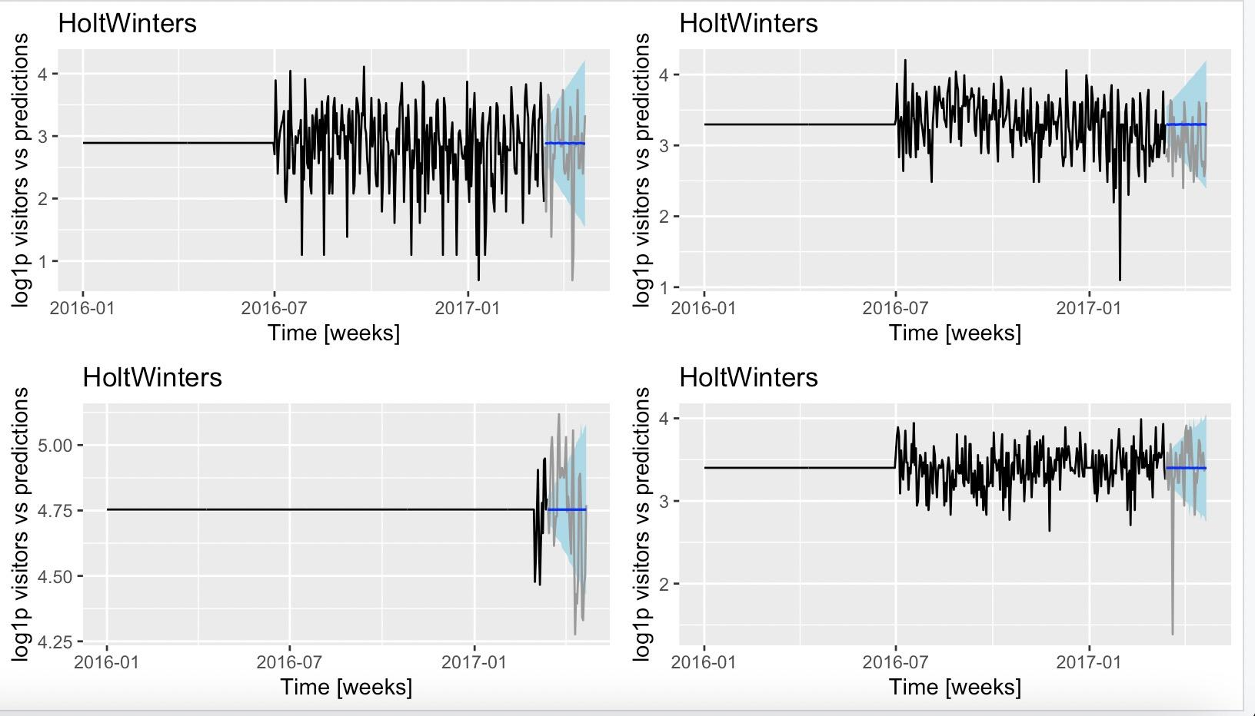
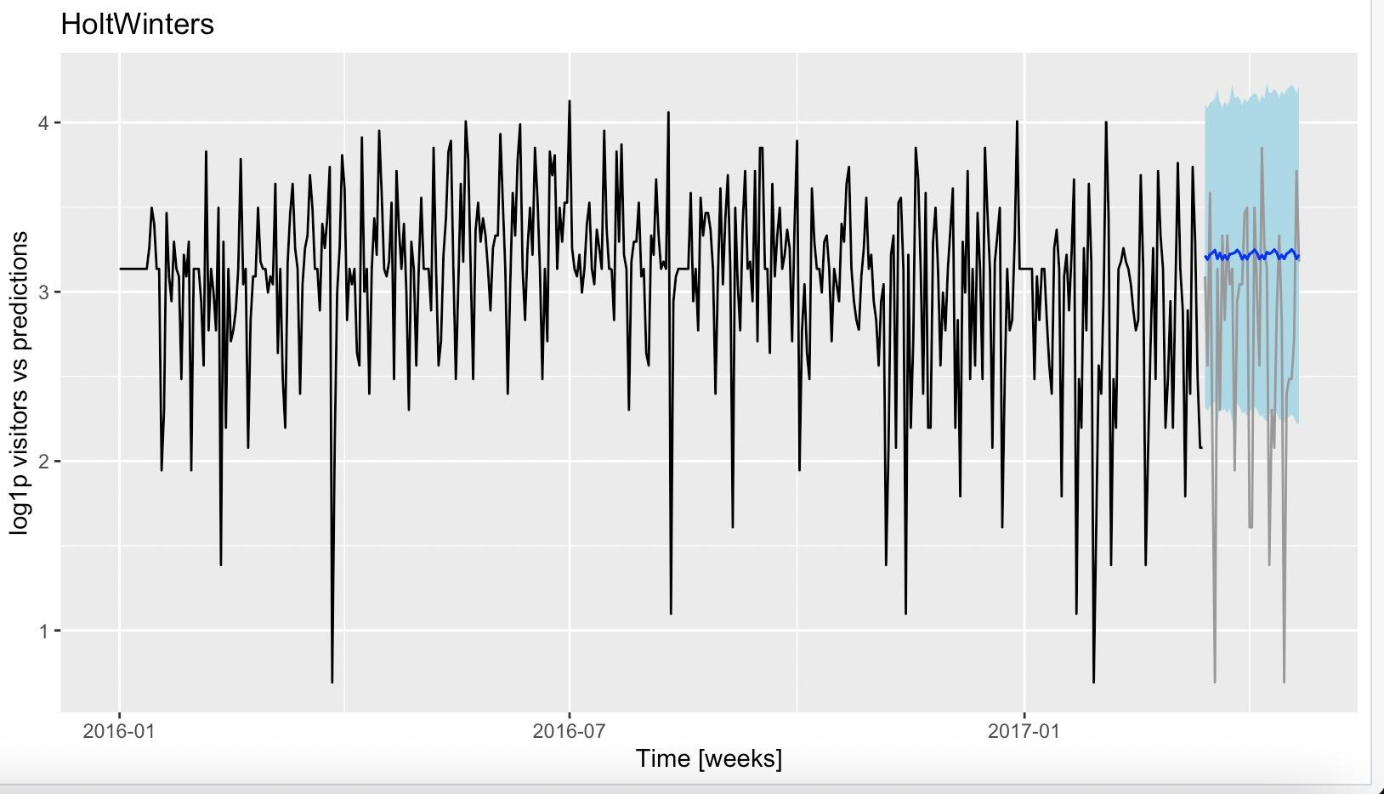
Model Demonstration
Holt Winters
This is an exponential smoothing method which uses moving averages to take into account the presence of a trend in the data.
We might get a better performance by discarding the missing values instead of replacing them with the median. the first impression looks less promising than the prophet approach.

Slide 52
THANK YOU FOR WATCHING!

